Slide 1
Introduction to CUDA
Jongsoo Kim (KASI)

Slide 2
Contents
Serial, Parallel, Hybrid Programming
GPGPU and Tesla GPU cards
CUDA examples
  Execution configuration (hello world)
  Global Memory (vector sum)
  Shared Memory (dot product)
  Texture Memory (heat equation)
  Constant Memory (??)
  Unified Virtual Memory (cuda6)

Slide 3
Serial Programming
Languages
  Fortran, C/C++, python, …
Optimization of Serial Codes
  Compilers,
  opts flags,
  math kernel, IPP (integrated Performance Primitives), ….
Intel AVX (Advanced Vector Extensions)
  256-bit SIMD vector extension

Slide 4
Parallel Programming
OpenMP
  SMP, incremental parallelization
CUDA (openCL)
  Coprocessor, incremental parallelization
MPI
  Cluster, needs sometimes many changes of serial codes

Slide 5
Hybrid Programming
OpenMP (MPI) + CUDA
  SMP, multiple GPUs
MPI + OpenMP
  Cluster of SMP nodes
MPI + CUDA
  Cluster, multiple GPUs
MPI + OpenMP + CUDA

Slide 6
CUDA vs. open CL
CUDA (Compute Unified Device Architecture) by Nvidia
Open CL (Computing Language) by Khronos

Slide 7
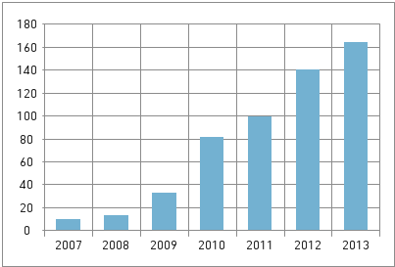
Astronomy Applications of GPU
N-body simulations
Fluid HD and MHD simulations
Radiative Transfer
Data processing, e.g., radio astronomy
etc…
ADS (search “GPU” in abstract)
  10 papers in 2007
  13 papers in 2008
  33 papers in 2009
  81 papers in 2010
  99 papers in 2011
  140 papers in 2012
  164 papers in 2013
  75 papers in 2014

Slide 8
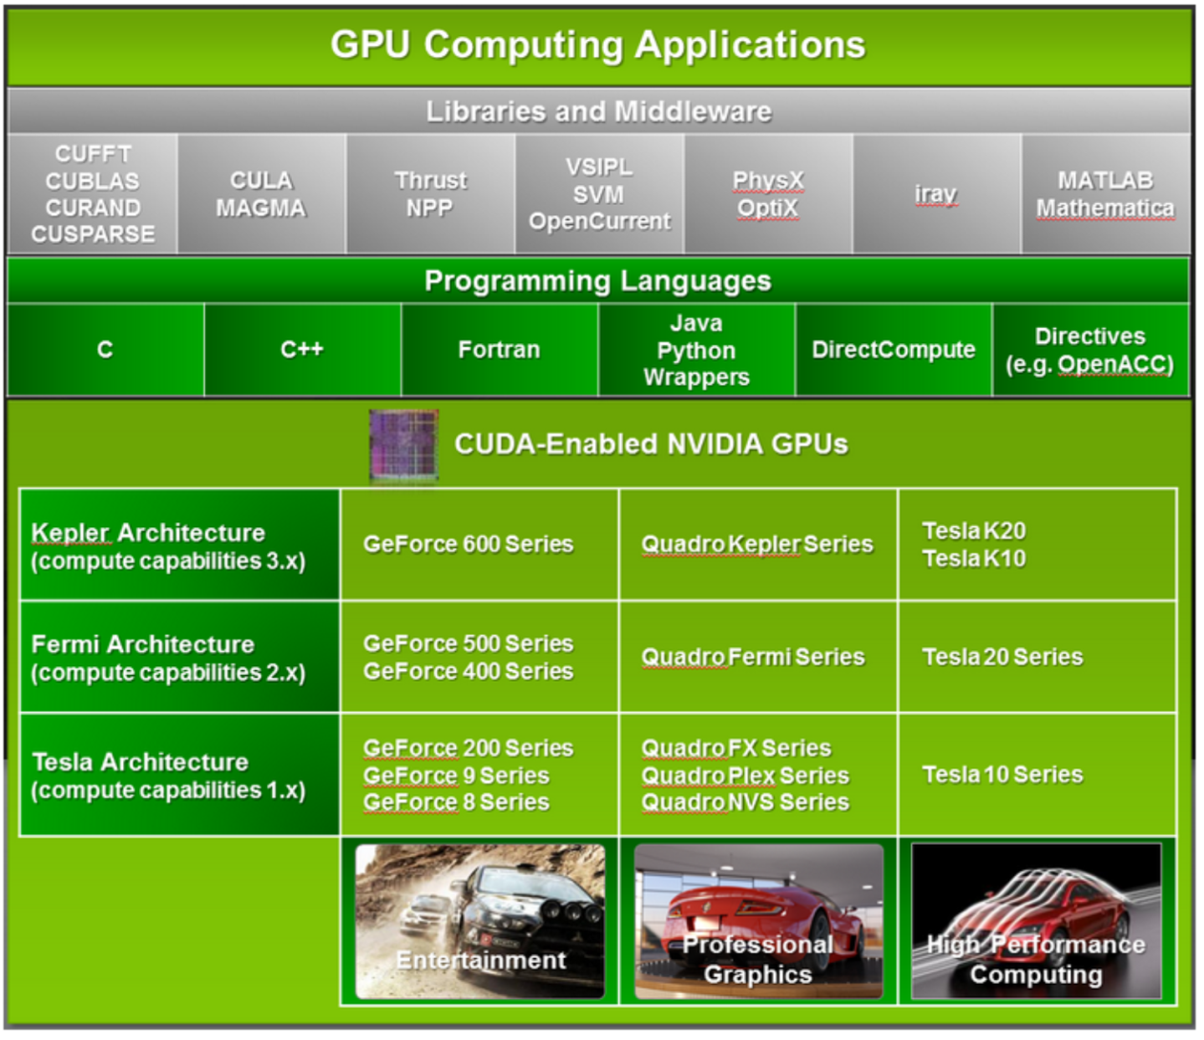

Slide 9
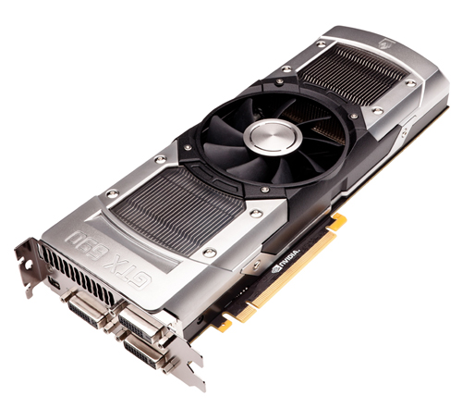
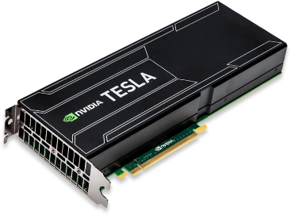
“Kepler” GPU cards

Slide 10
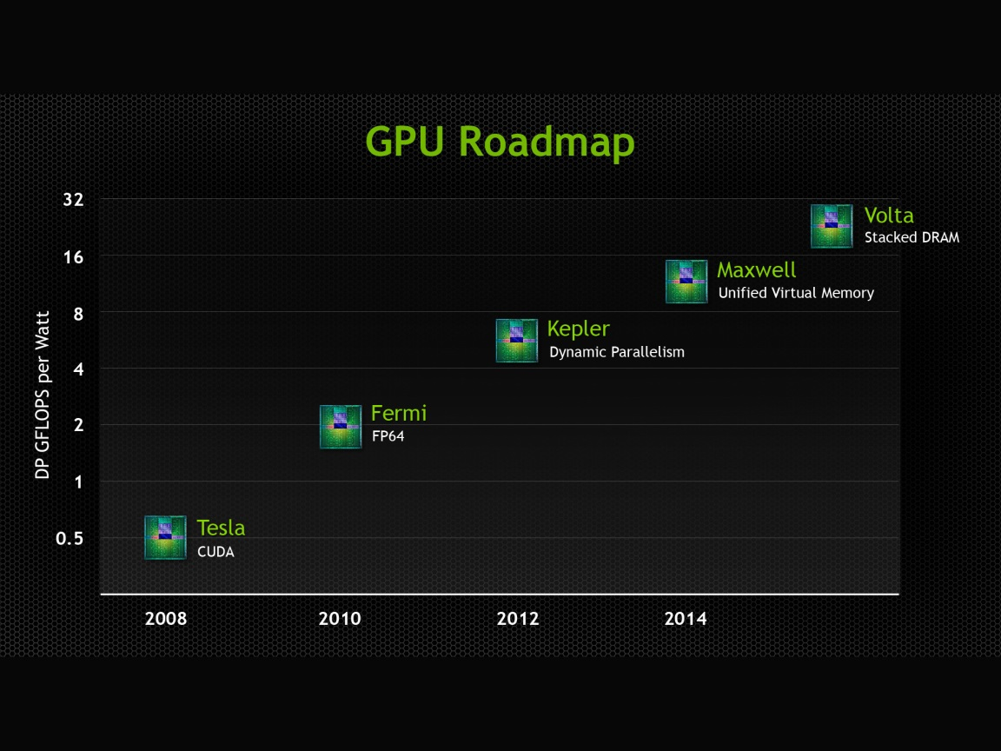

Tesla Roadmap

Slide 11
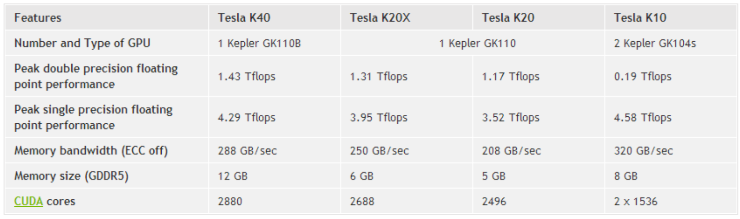
Specifications of
Kepler Tesla Boards

Slide 12
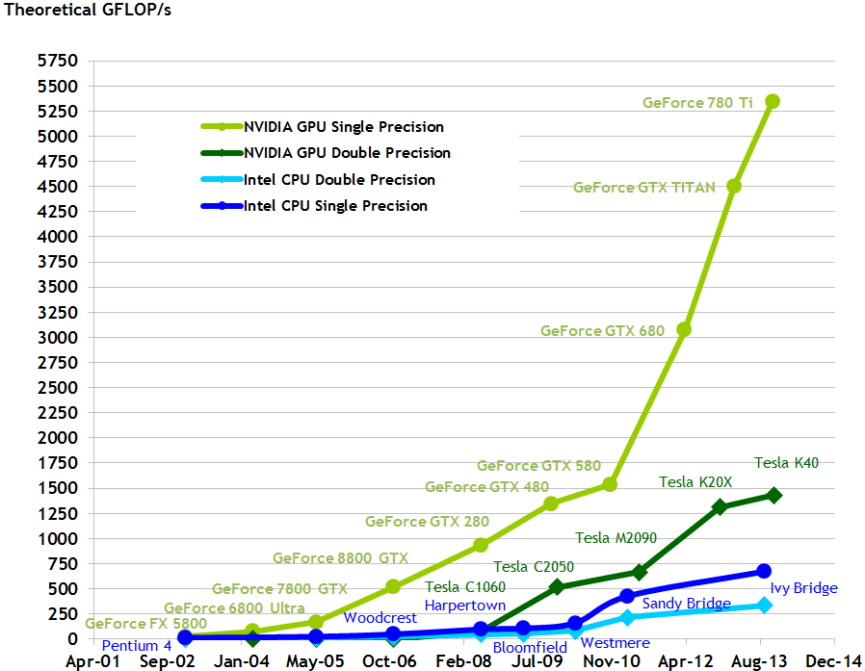
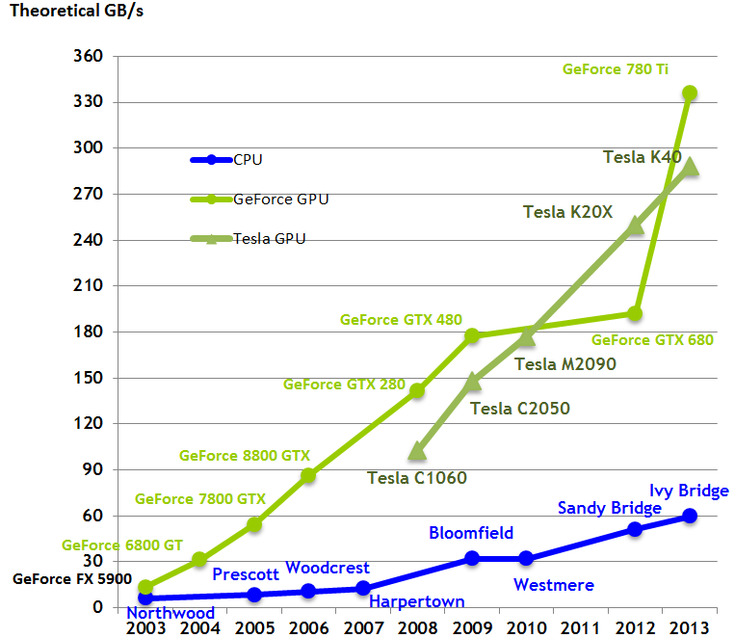
Performance and Bandwidth

Slide 13
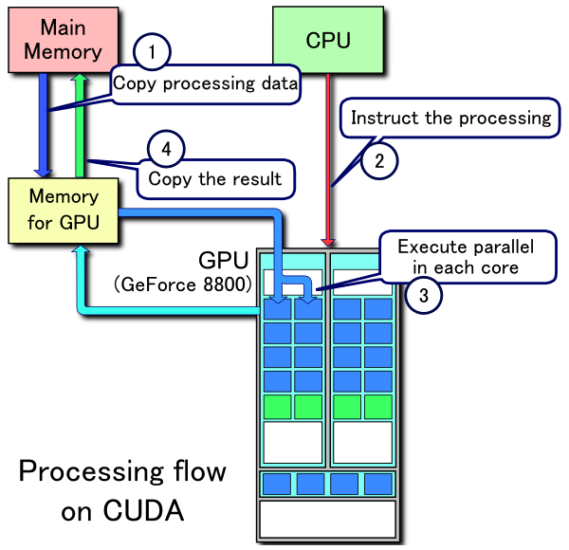
Processing flow
Bottlenecks
  PCIe bus: 8-16GB/s
  Memory BW:
  288 GB/s for TeslaK 40
  Memory latency:
  400-800 clock cycles

Slide 15
Device Memory Space

Slide 16
Access to a KIAS GPU cluster
From outside of the KIAS
  ssh cac@newton.kias.re.kr)
From inside of the KIAS or newton
  ssh guest@gpu.kias.re.kr
ssh gpu[01-24]
mkdir (your usual userid)
cd userid
cp ~guest/example/cuda/* .

Slide 17
Exercise 1: Hello world
#include <stdio.h>
void hello_world(void) {
printf(“Hello World\n”);
}
int main (void) {
hello_world();
return 0;
}

Slide 18
Exercise 1: Hello world
#include <stdio.h>
__global__ void hello_world(void) {
printf(“Hello World\n”);
}
int main (void) {
hello_world<<<1,5>>>();
cudaThreadExit();
return 0;
}

Slide 19
Compile and Run
nvcc –arch sm_20 hello.cu
./a.out
  Hello World
  Hello World
  Hello World
  Hello World
  Hello World

Slide 20
C Language Extensions
Function Type Qualifiers
  __global__
    executed on the device (GPU)
    callable from the host (CPU) only
    functions should have void return type
    any call to a __global__ function must specify the
    execution configuration for that call
  __device__
  executed on the device
  callable from the device only
  …

Slide 21
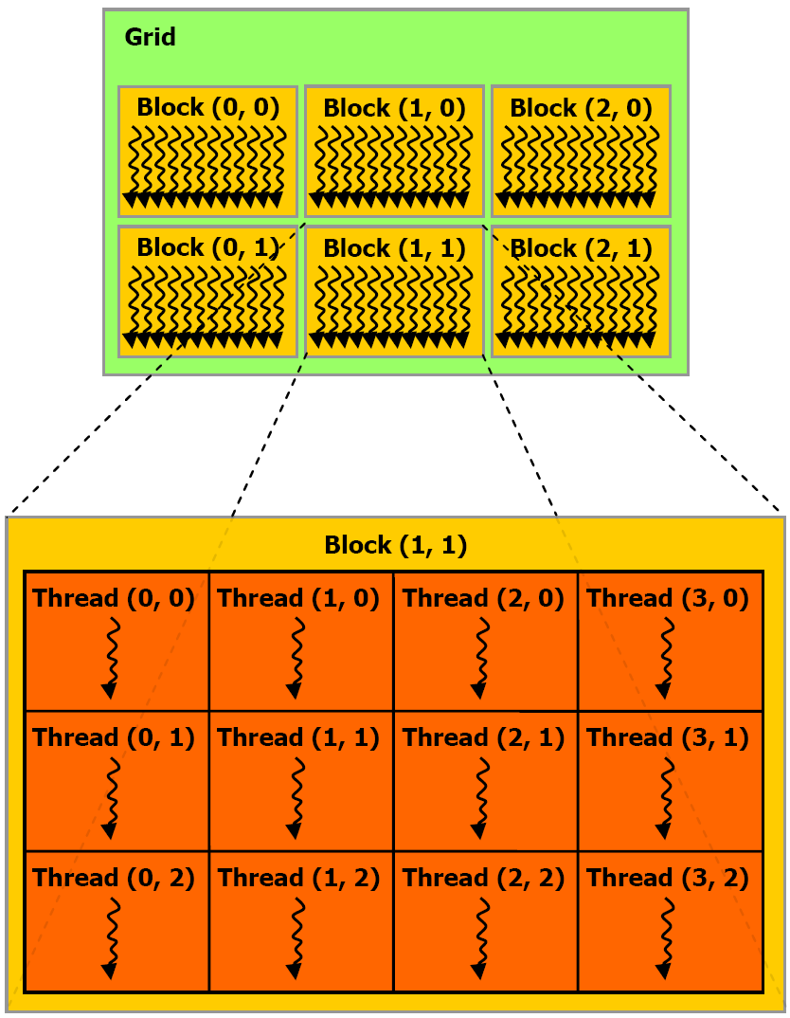
Grid, Block, Thread
Tesla S2050
  max. block size of each
  Dim per grid
  65535x65535x1
  max. thread size of
  each Dim per block
  1024x1024x64
  max. # of threads per block
  1024

Slide 22
Cuda version, DeviceQuery
Cuda version
nvcc –v
Device Query
/usr/local/cuda/samples/1_Utilities/deviceQuery/deviceQuery

Slide 23
C Language Extensions
Execution configuration
  <<<blocksPerGrid,threadsPerBlock>>>
  <<<1,1>>>
  <<<65535,1024>
  dim3 blocksPerGrid(65535,65535,1)
  dim3 threadsPerBlock(1024,1,1)
  <<<blocksPerGrid,threadsPerBlock>>>

Slide 24
C Language Extensions
Built-in Variables
  blockIdx = (blockIdx.x, blockIdx.y, blockIdx.y)
  three unsigned integers, uint3
  threadIdx = (threadIdx.x, threadIdx.y, threadIdx.y)
  three unsigned integers, uint3
Built-in Vector types
  dim3:
    Integer vector type based on unit3
    used to specify dimensions

Slide 25
Ex2: Execution Configuration
nvcc –arch sm_20 exec_conf_1d.cu
nvcc –arch sm_20 exec_conf_2d.cu
./a.out

Slide 26
Exercise 3: Vector sum
#include <stdio.h>
const int N=128;
void add(int *a, int *b, int *c) {
int i = 0;
while (i < N) {
c[i] = a[i] + b[i];
i += 1;
}
}

Slide 27
Exercise 3: Vector sum
int main (void) {
int a[N], b[N], c[N];
for (int i=0; i<N; i++) {
a[i] = -i;
b[i] = i * i;
}
add (a, b, c);
for (int i=0; i<N; i++) {
printf("%d + %d = %d\n", a[i],b[i],c[i]);
}
return 0;
}

Slide 28
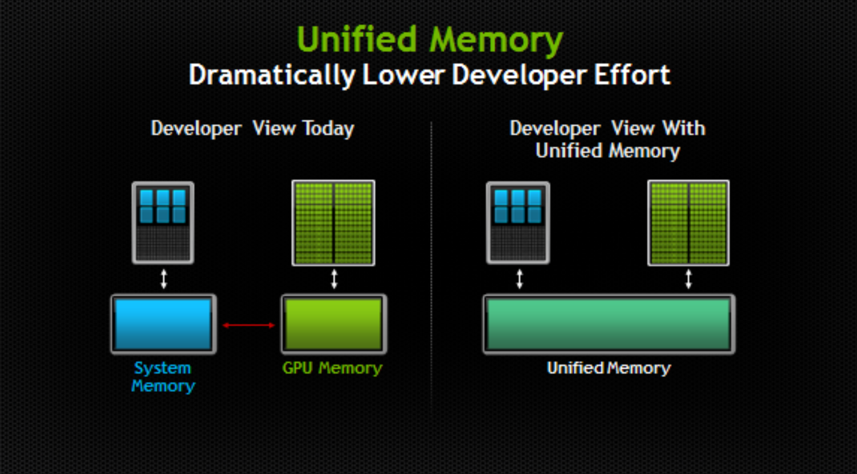

Slide 29
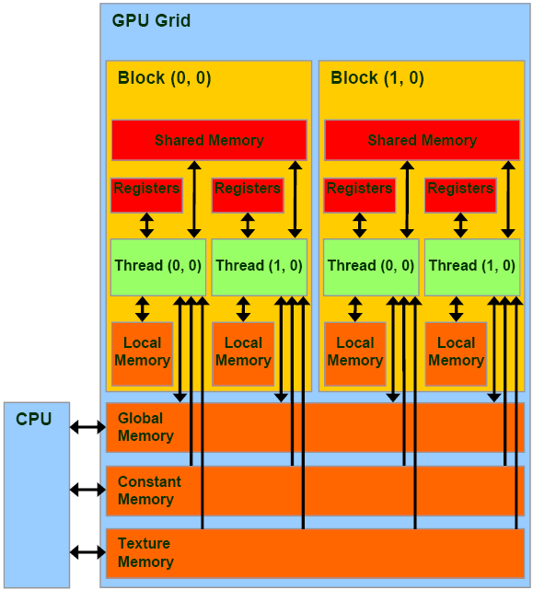

Slide 30
Exercise 3: Vector sum
nvcc vector_sum_block.cu
nvcc vector_sum_thread.cu
nvcc vector_sum_tb.cu
nvcc vector_sum_block.unified.cu

Slide 31
Exercise 4: Dot Product
#include <stdio.h>
#define sum_squares(x) (x*(x+1)*(2*x+1)/6)
const int N = 2048;
float dot_product(float *a, float *b) {
float c = 0.0f;
for (int i=0; i<N; i++)
c += a[i]*b[i];
return c;
}

Slide 32
int main (void) {
float a[N], b[N];
for (int i=0; i<N; i++) {
a[i] = (float) i;
b[i] = (float) i;
}
float c = dot_product(a,b);
printf("Dot prodoct of a and b = %f\n", c);
printf("sum_squares of (N-1) = %f\n",
sum_squares((float)(N-1)) );
return 0;
}

Slide 34
Exercise 4: Dot-Product
nvcc dot_product.cu
nvcc –arch sm_13 dot_product_double.cu
nvcc dot_product_cublas.cu

Slide 35
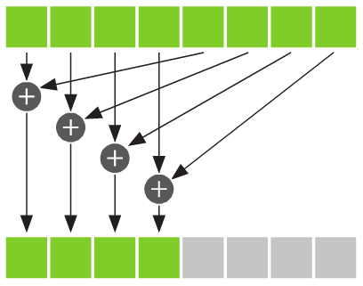
Reduction
blockIdx 0
blockIdx 1
blockIdx 2
blockIdx 3

Slide 36
cuBLAS
Basic Linear Algebra Subprograms on CUDA
  cublasHandle_t handle=0;
  cublasCreate(&handle)
  cublasSdot(handle,N,dev_a,1,dev_b,1,&c);
  cublasDestroy(handle);

Slide 37
Exercise 5: Matrix-Matrix Multiplication
nvcc –arch sm_20 matmul_global.cu
nvcc –arch sm_20 matmul_shared.cu

Slide 38
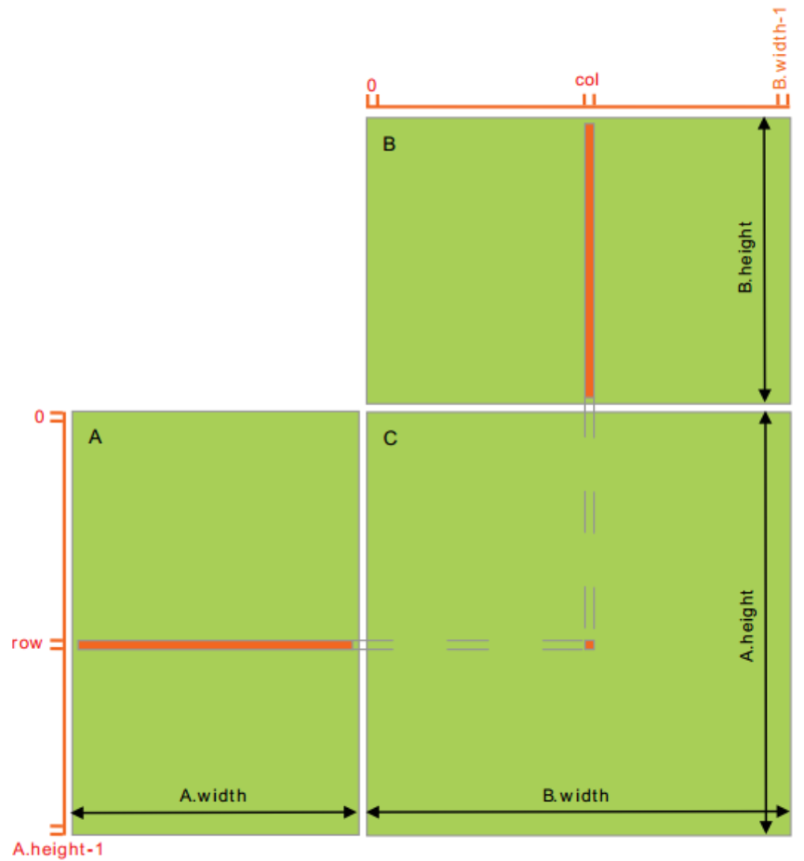
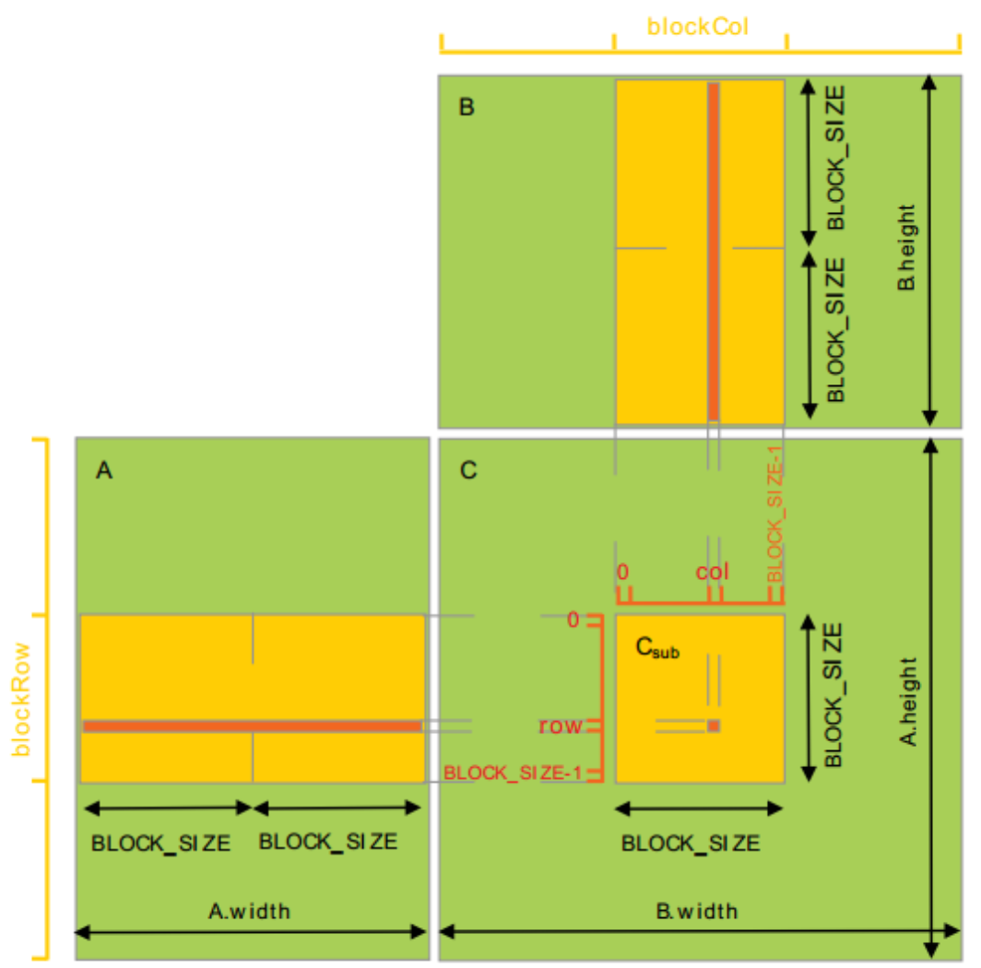
Global vs. Shared

Slide 39
AI (Arithmetic Intensity)
Definition: number of operations per byte
AI for a[N]+b[N]
N ops / 8N bytes = 1/8
AI for A[N][N] * B[N][N]
2N³ ops/ 8N² bytes = N/4
If AI ~ 1, performance = AI x memory BW
If AI >~ 40(2.x),15(1.x), can the hide latency of global memory → better performance

Slide 40
Heat equation

Slide 41
Exercise 6: heat equation
nvcc –arch sm_20 heat_global.cu
nvcc –arch sm_20 heat_texture.cu

Slide 42
Correlation Theorem
F-step (FT):
~log₂(N_{c}) operations per sample
X-step (CMAC):
~ N operations per sample

Slide 43
AI for software correlation
AI = 8flops/16bytes (R_{i},R_{j}) = 0.5
AI = 32 flops/32bytes (R_{i}, L_{i}, R_{j}, L_{j}) = 1.0
for 1x1 tile
AI = 2.4 for 3x2 tiles
Since AIs are small numbers, correlation calculations are bounded by the memory bandwidth.
Performance: AI x memory BW (=102GB/s for Tesla C1060)

Slide 44
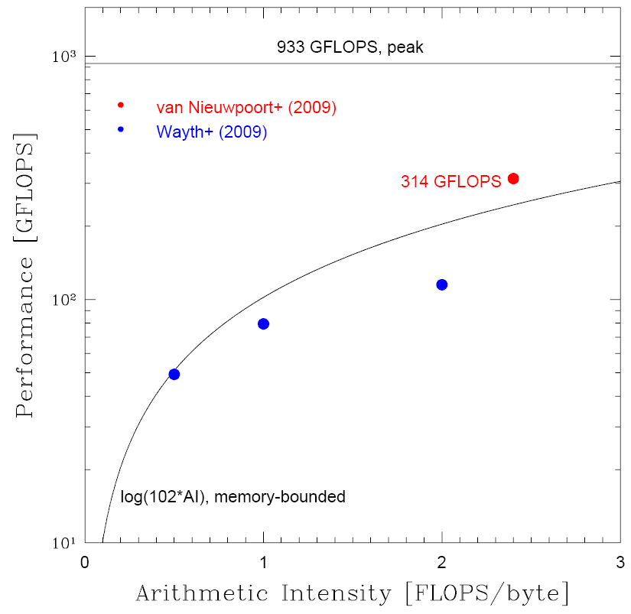
Performance of Tesla C1060 for software correlation
Performance is
memory-bounded.
Maximum
performance is
about 1/3 of the
peak performance.

Slide 45
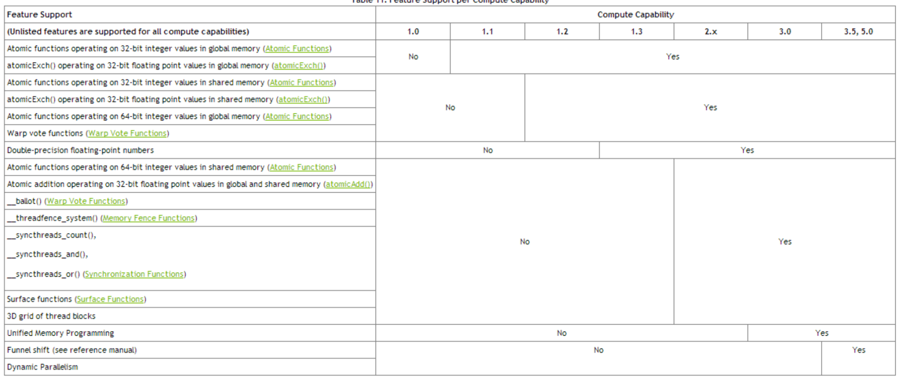
Compute Capability

Slide 46
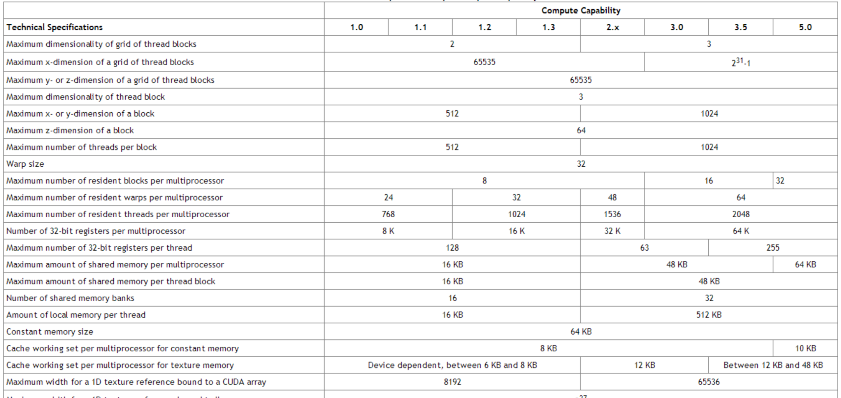
Compute Capability

Slide 47
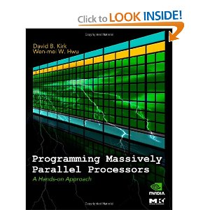

Cuda Books

Slide 48
Useful information
http://developer.nvidia.com
CUDA toolkit 5.5, 6.0
Getting Started Guide (installation)
CUDA C programming Guide

