Slide 1
KIAS CAC Summer School cuBLAS Tutorial
Hyungon Ryu 류현곤 hryu@nvidia.com

Slide 2
BLAS Parameters
Netlib fortran BLAS
DGEMM(TRANSA, TRANSB,
M, N, K,
ALPHA,
A, LDA, B, LDB,
BETA,
C, LDC )
DGEMM means NOT C := A * B
DGEMM means BUT C := alpha*op( A ) * op( B ) + beta*C
TRANSA/B ( N or T/C)
A,B,C : 2D Array (MxN = MxK * KxN)

Slide 3
DGEMM example in GSL
#include <stdio.h>
#include <gsl/gsl_blas.h>
int main (void) {
double a[ ] = { 0.11, 0.12, 0.13, 0.21, 0.22, 0.23 };
double b[ ] = { 1011, 1012, 1021, 1022, 1031, 1032 };
double c[ ] = { 0.00, 0.00, 0.00, 0.00 };
gsl_matrix_view A = gsl_matrix_view_array(a, 2, 3);
gsl_matrix_view B = gsl_matrix_view_array(b, 3, 2);
gsl_matrix_view C = gsl_matrix_view_array(c, 2, 2);
/* Compute C = A B */
gsl_blas_dgemm (CblasNoTrans, CblasNoTrans,
1.0, &A.matrix, &B.matrix, 0.0,
&C.matrix);
printf ("[ %g, %g\n", c[0], c[1]);
printf (" %g, %g ]\n", c[2], c[3]);
return 0;
}

Slide 4
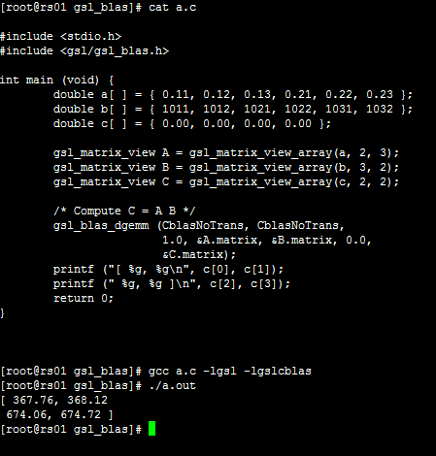
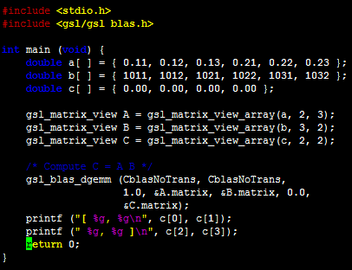
DGEMM example in GSL

Slide 5
DGEMM example in MKL
syntax :
void dgemm(char *transa, char *transb, int *m, int *n, int *k,
double *alpha, double *a, int *lda,
double *b, int *ldb,
double *beta, double *c, int *ldc);
Compile :
$(MKL_PATH) = /usr/local/intel-11.1.059/mkl/lib/em64t
icc my_src.c -lmkl_core -lmkl_intel_lp64 -lmkl_sequential

Slide 6
DGEMM example in MKL
#include <stdio.h>
#include <mkl.h>
int main(void) {
double *a, *b, *c; int n, i; double alpha, beta; MKL_INT64 AllocatedBytes; int N_AllocatedBuffers;
alpha = 1.1; beta = -1.2; n = 1000;
a = (double*)mkl_malloc(n*n*sizeof(double),128);
b = (double*)mkl_malloc(n*n*sizeof(double),128);
c = (double*)mkl_malloc(n*n*sizeof(double),128);
for (i=0;i<(n*n);i++) { a[i] = (double)(i+1); b[i] = (double)(-i-1); c[i] = 0.0; }
dgemm("N","N",&n,&n,&n,&alpha,a,&n,b,&n,&beta,c,&n);
AllocatedBytes = mkl_mem_stat(&N_AllocatedBuffers);
printf("\nDGEMM uses %ld bytes in %d buffers",(long)AllocatedBytes,N_AllocatedBuffers);
mkl_free_buffers();
AllocatedBytes = mkl_mem_stat(&N_AllocatedBuffers);
if (AllocatedBytes > 0) {
printf("\nMKL memory leak!");
printf("\nAfter mkl_free_buffers there are %ld bytes in %d buffers", (long)AllocatedBytes,N_AllocatedBuffers);
}
mkl_free(a);
mkl_free(b);
mkl_free(c);
return 0;
}

Slide 7
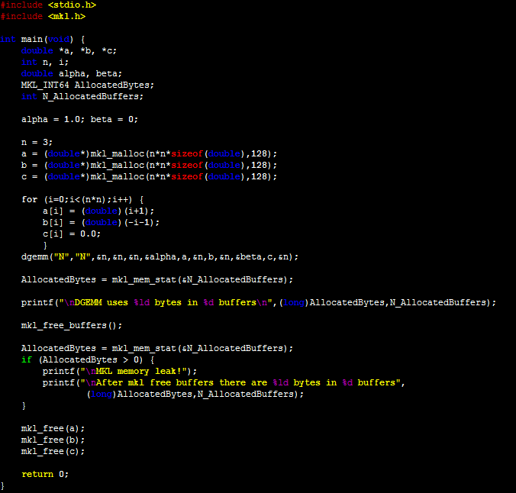
DGEMM example in MKL

Slide 8
CPU version SGEMM routine
static void simple_sgemm(int n, float alpha, const float *A, const float *B,
float beta, float *C)
{
int i, j, k;
for (i = 0; i < n; ++i) {
for (j = 0; j < n; ++j) {
float prod = 0;
for (k = 0; k < n; ++k) {
prod += A[k * n + i] * B[j * n + k];
}
C[j * n + i] = alpha * prod + beta * C[j * n + i];
}
}
}

Slide 9
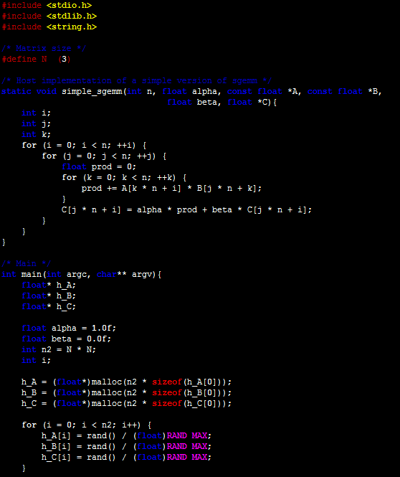
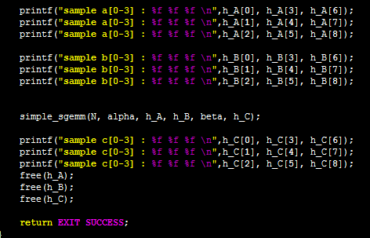
CPU version SGEMM routine

Slide 10
CPU version DGEMM routine
static void simple_dgemm(int n, double alpha, const double *A, const double *B,
double beta, double *C)
{
int i, j, k;
for (i = 0; i < n; ++i) {
for (j = 0; j < n; ++j) {
double prod = 0;
for (k = 0; k < n; ++k) {
prod += A[k * n + i] * B[j * n + k];
}
C[j * n + i] = alpha * prod + beta * C[j * n + i];
}
}
}

Slide 11
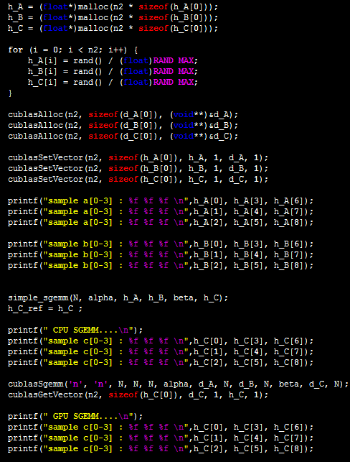
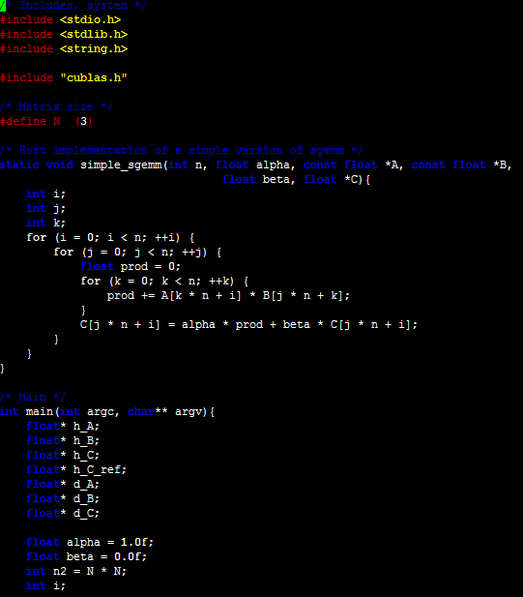
sgemm in cuBLAS

Slide 12
Main code in cuBLAS
h_A = (float*) malloc(n2 * sizeof(h_A[0]));
h_B = (float *) malloc(n2 * sizeof(h_B[0]));
h_C = (float *) malloc(n2 * sizeof(h_C[0]));
cublasAlloc (n2, sizeof(d_A[0]), (void**)&d_A );
cublasAlloc (n2, sizeof(d_B[0]), (void **)&d_B );
cublasAlloc (n2, sizeof(d_C[0]), (void **)&d_C );
cublasSetVector (n2, sizeof(h_A[0]), h_A, 1, d_A, 1 );
cublasSetVector (n2, sizeof(h_B[0]), h_B, 1, d_B, 1 );
cublasSetVector (n2, sizeof(h_C[0]), h_C, 1, d_C, 1 );
cublasSgemm('n', 'n', N, N, N, alpha, d_A, N, d_B, N, beta, d_C, N );
cublasGetVector(n2, sizeof(h_C[0]), d_C, 1, h_C, 1 );

Slide 13
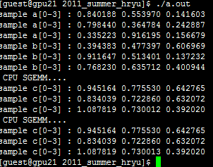
Compare DGEMM CPU vs GPU

Slide 14
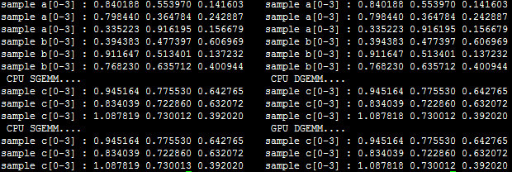
DGEMM in cuBLAS
SGEMM
DGEMM
For DGEMM,
Need GT200, GF100 architecture ( H/W)

Slide 15
Homework
CG with cuBLAS
Reference…
cuBLAS programming guide…

Slide 16
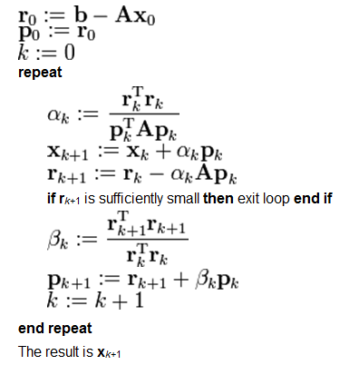
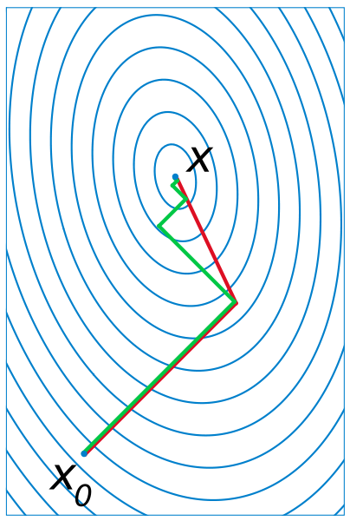
CG slover in cuBLAS
Matlab command for Conjugate Gradient
n=1000;
[U,S,V]=svd(randn(n));
s=diag(S);
A=U*diag(s+max(s))*U';
b=randn(1000,1);
x=cgs(A,b);

Slide 17
Matlab cocde for cgs(A,b,x)
function [x] = conjgrad(A,b,x) r = b - A*x; p = r + 0*0 ; rsold = r'*r; for i=1:size(A)(1) Ap = A*p; alpha = rsold/(p'*Ap); x = x + alpha*p; r = r - alpha*Ap; rsnew = r'*r; if sqrt(rsnew)<1e-10 break; end beta = rsnew/rsold p = r + beta*p; rsold = rsnew; end end | Initial resitual Initial direction easy to compute easy to compute step size updated solution residual easy to compute modify factor direction update update p' means transpose(p)
dgemv
dgemv
ddot
daxpy
ddot
daxpy

Slide 18
GPU Matrix Solvers
Dense matrix
  Jacket http://www.accelereyes.com/
  Acceleware http://www.acceleware.com/matrix-solvers
  CULA http://www.culatools.com/
  MAGMA http://icl.cs.utk.edu/magma/
  CUDA-HPL contact hryu@nvidia.com for new version
Sparse matrix
  Acceleware. http://www.acceleware.com/matrix-solvers
  openNL 3.0 http://alice.loria.fr/index.php/software/4-library/23-opennl.html
  GSS, MatrixPro http://www.grusoft.com/GSS.htm

Slide 19
Matrix Mul in SDK sample
matrixMul( float* C, float* A, float* B, int wA, int wB){
int bx = blockIdx.x;
int by = blockIdx.y;
int tx = threadIdx.x;
int ty = threadIdx.y;
int aBegin = wA * BLOCK_SIZE * by;
int aEnd = aBegin + wA - 1;
int aStep = BLOCK_SIZE;
int bBegin = BLOCK_SIZE * bx;
int bStep = BLOCK_SIZE * wB;
float Csub = 0;
for (int a = aBegin, b = bBegin;
a <= aEnd;
a += aStep, b += bStep) {
__shared__ float As[BLOCK_SIZE][BLOCK_SIZE];
__shared__ float Bs[BLOCK_SIZE][BLOCK_SIZE];
AS(ty, tx) = A[a + wA * ty + tx];
BS(ty, tx) = B[b + wB * ty + tx];
__syncthreads();
#pragma unroll
for (int k = 0; k < BLOCK_SIZE; ++k)
Csub += AS(ty, k) * BS(k, tx);
__syncthreads();
}
int c = wB * BLOCK_SIZE * by + BLOCK_SIZE * bx;
C[c + wB * ty + tx] = Csub;
}

