Slide 1
Intel® Math Kernel Library
Seungwoo Lee
KISTI Supercomputing Center
Moasys Corp.

Slide 2
Speed Up your Code
Using Compiler Option(-On -fast …)
Using Library(LAPACK, MKL, ACML, ESSL,…)
Hand Tuning(Unrolling, Inlining, Blocking, …)
Parallelizing(MPI, OpenMP, …)

Slide 3
Matrix Multiplication
PROGRAM MMU
IMPLICIT NONE
INTEGER, PARAMETER :: N=2048
REAL(8), DIMENSION(N,N) :: A, B, C
…
DO J=1,ND
J=DFLOAT(J)
DO I=1,NDI=DFLOAT(I)
A(I,J)=1.D-3*DI+1.D-6*DJ
B(I,J)=1.D-3*(DI+DJ)+1.D-6*(DI-DJ)
C(I,J)=0.D0
END DO
END DO
DO J=1,N
DO I=1,N
DO K=1,N
C(I,J)=C(I,J)+A(I,K)*B(K,J)
END DO
END DO
END DO
END

Slide 4
Using Library
PROGRAM MMU
IMPLICIT NONE
INTEGER, PARAMETER :: N=2048
REAL(8), DIMENSION(N,N) :: A, B, C
…
DO J=1,ND
J=DFLOAT(J)
DO I=1,NDI=DFLOAT(I)
A(I,J)=1.D-3*DI+1.D-6*DJ
B(I,J)=1.D-3*(DI+DJ)+1.D-6*(DI-DJ)
C(I,J)=0.D0
END DO
END DO
CALL DGEMM('N', 'N', N, N, N, 1.0D0, A, ND, B, ND, 0.0D0, C, ND)
END

Slide 5
Hand coding performance
Tachyon2 Intel Xeon X5570(Nehalem) 2.93GHz, PGI 9.0
  pgf90 mm.f90: 143.09 secs
  pgf90 mm.f90 –fast –tp nehalem-64: 13.31 secs
  pgf90 mmbup.f90: 12.45 secs
  pgf90 mmbup.f90 –fast –tp nehalem-64: 9.18 secs
OpenMP Parallelization: OMP_NUM_THREADS=4
  pgf90 –mp mm_omp.f90: 49.88 secs
  pgf90 -mp mm_omp.f90 -fast -tp nehalem-64: 4.62 secs

Slide 6
Using Library
BLAS
  pgf90 mmblas.f90 –lblas: 19.30 secs
Intel® Math Kernel Library
  pgf90 mmblas.f90 -lmkl_intel_lp64
  –lmkl_sequential -lmkl_core : 1.43 secs
  pgf90 mmblas.f90 –lmkl_intel_lp64
  -lmkl_pgi_thread –lmkl_core –mp: 0.39 secs
  (Multi-threading: OMP_NUM_THREADS=4)

Slide 7
Math kernel library

Slide 8
MKL Functionality
Dense Linear Algebra - BLAS, LAPACK
Sparse Linear Algebra - Direct sparse solver, iterative sparse solver, sparse BLAS
Fast Fourier transforms
Vector Math Library (VML)
Vector Statistical Library (VSL)
Thread-safe and extensively threaded using the OpenMP* technology
Cluster Support - ScaLAPACK, Cluster FFT
http://software.intel.com/sites/products/documentation/hpc/mkl/mklman/index.htm

Slide 9
Requirements
H/W
  IA-32, Intel® 64 Architecture
OS
  Windows or Linux
Compilers (Fortran, C/C++)
  Linux – Intel, GNU, PGI
  Windows – Intel, MS, PGI
MPI
  Linux – Intel, MPICH2, OpenMPI, SGI MPT
  Windows – Intel, MPICH2, MS MPI

Slide 10
Install
http://software.intel.com/en-us/articles/intel-software-evaluation-center/
install script
  install.sh
setting environment variables
  . <absolute_path_to_installed_MKL>/bin [/<arch>]/mklvars[<arch>].sh [<arch>] [mod] [lp64|ilp64]
  example
    . /home01/suncode2/intel/mkl/bin/intel64/mklvars_intel64.sh ilp64
    . /home01/suncode2/intel/bin/compilervars.sh intel64

Slide 11
What You Need to Know Before You Begin Using MKL
Target Platform/Mathematical Problem/Language
Range of integer data
  LP64 or ILP64(large data arrays)
Threading Model
  Threaded with the Intel compiler
  Threaded with a 3rd party compiler
  Not threaded
Number of threads
Linking model
  Static or Dynamic
MPI used(ScaLAPACK or Cluster FFT)
  Library link

Slide 12
Layered model
Interface layer
  LP64 or ILP64 interface
  SP2DP interface(Cray-style naming)
Threading layer
  Threaded or sequential mode of the library
  Threaded MKL → 3rd party threading compilers
Computational layer
Compiler support Run-Time Libraries(RTL)
  To support threading with Intel compilers

Slide 13
Link
 | Interface layer | Threading layer | Computational layer | RTL
IA-32 static | libmkl_intel.a | libmkl_intel_thread.a | libmkl_core.a | libiomp5.so
IA-32 dynamic | libmkl_rt.so
Intel® 64 static | libmkl_intel_lp64.a | libmkl_intel_thread.a | libmkl_core.a | libiomp5.so
Intel® 64 dynamic | libmkl_rt.so

Slide 14
Link(dynamic)
<files to link>
-L<MKL path> -I<MKL include>
[-I<MKL include>/{ia32|intel64|{ilp64|lp64}}]
[-lmkl_blas{95|95_ilp64|95_lp64}]
[-lmkl_lapack{95|95_ilp64|95_lp64}]
[<cluster components>]
-lmkl_{intel|intel_ilp64|intel_lp64|intel_sp2dp|gf|gf_ilp64|gf_lp64}
-lmkl_{intel_thread|gnu_thread|pgi_thread|sequential}
-lmkl_core
-liomp5 [-lpthread] [-lm]
ifort mmblas.f90 –o mmblas
-lmkl_intel_lp64 -lmkl_intel_thread -lmkl_core -liomp5 –lpthread

Slide 15
Link(Static)
<files to link>
-L<MKL path> -I<MKL include>
-Wl,--start-group $MKLPATH/libmkl_cdft_core.a $MKLPATH/libmkl_blacs_intelmpi_ilp64.a $MKLPATH/libmkl_intel_ilp64.a $MKLPATH/libmkl_intel_thread.a $MKLPATH/libmkl_core.a -Wl,--end-group -liomp5 [-lpthread] [-lm]
ifort mmblas.f90 –o mmblas
-Wl,--start-group $MKLIB/libmkl_intel_lp64.a $MKLIB/libmkl_intel_thread.a $MKLIB/libmkl_core.a
–Wl,--end-group -liomp5 -lpthread

Slide 16
Interface Layer
ILP64
  Use the 64-bit integer type(for indexing large arrays)
  Compile option: -i8(Fortran), -DMKL_ILP64(C/C++)
LP64
  32-bit integer type
libmkl_intel_ilp64/libmkl_intel_lp64 libmkl_gf_ilp64/libmkl_gf_lp64 libmkl_intel_sp2dp

Slide 17
Coding for ILP64
Integer types | Fortran | C/C++
32-bit integers | INTEGER*4 or INTEGER(KIND=4) | int
Universal integers for ILP64/LP64 64-bit for ILP64 32-bit otherwise | INTEGER without specifying KIND | MKL_INT
Universal integers for ILP64/LP64 64-bit integers | INTEGER*8 or INTEGER(KIND=8) | MKL_INT64
FFT interface integers for ILP64/LP64 | INTEGER without specifying KIND | MKL_LONG
FFTW 2.x wrappers do not support ILP64
GMP arithmetic functions do not support ILP64

Slide 18
Threading layer
libmkl_intel_thread libmkl_sequential libmkl_gnu_thread libmkl_pgi_thread
Sequential mode
  Unthreaded code
  Thread-safe
  Add libpthread (recommended)
  You should use the library in the sequential mode only if you have a particular reason not to use Intel MKL threading.
Threaded mode
  Add libpthread (recommended)
  Add RTL(libiomp5)
  ifort mmblas.f90 -lmkl_blas95_lp64 -lmkl_intel_lp64 -lmkl_intel_thread -lmkl_core -liomp5 -lpthread

Slide 19
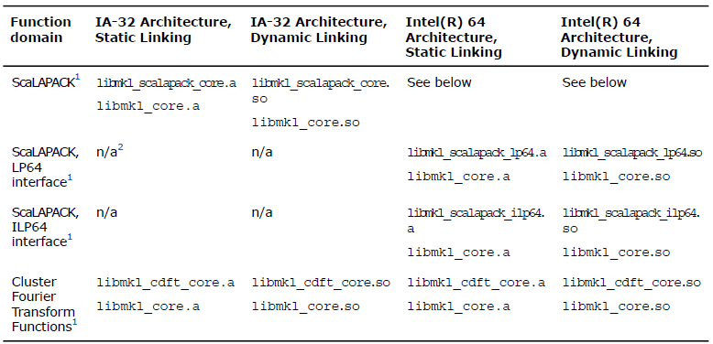
Computational layer
not using the MKL cluster software
  libmkl_core
Using the ScaLAPACK or cluster FFT

Slide 20
RTL and System libraries.
Threaded mode
  Link with libiomp5 dynamically even if other libraries are linked statically.
  Add libpthread
  If you link with dynamic version of libiomp5, make sure the LD_LIBRARY_PATH environment variable is defined correctly.
To use the MKL FFT, Trigonometric Transform, or Poisson, Laplace, and Helmholtz Solver routines, link in the math support system library by adding " -lm " to the link line.

Slide 21
Single Dynamic Library Interface
Dynamically select the interface and threading layer at runtime
  libmkl_rt
  Threading layer
    Environment variables: MKL_THREADING_LAYER
      INTEL(default)/PGI/GNU/SEQUENTIAL
    Functions: mkl_set_threading_layer
      MKL_THREADING_INTEL
      MKL_THREADING_PGI
      MKL_THREADING_GNU
      MKL_THREADING_SEQUENTIAL
  Interface layer
    Environment variables: MKL_INTERFACE_LAYER
      LP64(default)/ILP64
    Function: mkl_set_interface_layer
      MKL_INTERFACE_LP64
      MKL_INTERFACE_ILP64

Slide 22
SDL examples
export MKL_THREADING_LAYER=INTEL
export MKL_INTERFACE_LAYER=ILP64
ifort mmblas.f90 –lmkl_rt -liomp5

Slide 23
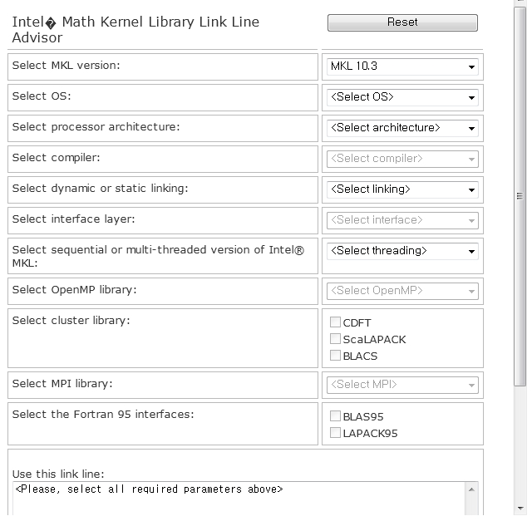
Web-based linking advisor
http://software.intel.com/en-us/articles/intel-mkl-link-line-advisor

Slide 24
Thread Parallelism
Thread-safe
  except the LAPACK deprecated routine *lacon
Number of Threads
  # of threads = # of physical cores (default)
  Environment variables
    MKL_NUM_THREADS
    OMP_NUM_THREADS
  Function call
    mkl_set_num_threads
    omp_set_num_threads
Threaded Functions and Problems
  See the manual.

Slide 25
Matrix Multiplication
ifort mmblas.f90 -lmkl_intel_lp64
-lmkl_intel_thread -lmkl_core -liomp5
  OMP_NUM_THREADS=2: 0.82 secs
  OMP_NUM_THREADS=4: 0.41 secs
  OMP_NUM_THREADS=8: 0.23 secs

Slide 26
VML/VSL
include 'mkl_vsl.f90'
use mkl_vsl_type
use mkl_vsl
integer, parameter :: N=5000
real(8), dimension(N,N) ::A,B,C
real(8) lb, ub
integer status, brng, seed, method
type(VSL_STREAM_STATE) :: stream
integer(8) :: t1, t2, hz
brng = VSL_BRNG_MCG31
seed = 313
method = VSL_RNG_METHOD_UNIFORM_STD
status = vslnewstream(stream,brng,seed)
lb=0.0; ub=1.0
status = vdrnguniform(method,stream,N*N,B,lb,ub)
lb=1.0; ub=2.0
status = vdrnguniform(method,stream,N*N,C,lb,ub)

Slide 27
VML/VSL
call system_clock(count_rate=hz)
call system_clock(t1)
do j=1,N
do i=1,N
A(i,j) = B(i,j)**C(i,j)
enddo
enddo
call system_clock(t2)
print*, "scalar processing time =", (t2-t1)/real(hz)
call system_clock(t1)
call vdpow(N*N,B,C,A)
call system_clock(t2)
print*, "vector processing time =", (t2-t1)/real(hz)
end

Slide 28

VML/VSL
ifort vpow.f90 -lmkl_intel_lp64
-lmkl_intel_thread -lmkl_core -liomp5

Slide 29
ScaLAPACK
Scalable LAPACK
  http://www.netlib.org/scalapack/
  http://www.netlib.org/scalapack/slug/index.html
ScaLAPACK
PBLAS
Global
Local
BLACS
LAPACK
BLAS
Message Passing Primitives
(MPI, PVM, etc)

Slide 30
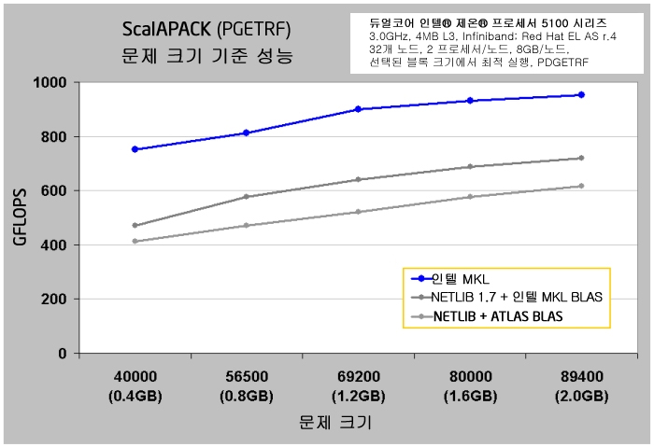
MKL ScaLAPACK
(http://www.intel.com/cd/software/products/apac/kor/329216.htm)

Slide 31
6 Steps to call a ScaLAPACK Routine
Initialize the BLACS
Initialize the process grid
Distribute the matrix on the process grid
Call ScaLAPACK routine
Release the process grid
Finalize the BLACS

Slide 32
Distribute the Matrix on the process grid
2-D Block-Cyclic Data Distribution
0
1
2
a₁₁
a₁₂
a₁₃
a₁₄
a₁₅
a₁₆
a₁₇
a₁₈
a₁₉
a₁₁
a₁₂
a₁₇
a₁₈
a₁₃
a₁₄
a₁₉
a₁₅
a₁₆
a₂₁
a₂₂
a₂₃
a₂₄
a₂₅
a₂₆
a₂₇
a₂₈
a₂₉
a₂₁
a₂₂
a₂₇
a₂₈
a₂₃
a₂₄
a₂₉
a₂₅
a₂₆
a₃₁
a₃₂
a₃₃
a₃₄
a₃₅
a₃₆
a₃₇
a₃₈
a₃₉
0
a₅₁
a₅₂
a₅₇
a₅₈
a₅₃
a₅₄
a₅₉
a₅₅
a₅₆
a₄₁
a₄₂
a₄₃
a₄₄
a₄₅
a₄₆
a₄₇
a₄₈
a₄₉
a₆₁
a₆₂
a₆₇
a₆₈
a₆₃
a₆₄
a₆₉
a₆₅
a₆₆
a₅₁
a₅₂
a₅₃
a₅₄
a₅₅
a₅₆
a₅₇
a₅₈
a₅₉
a₉₁
a₉₂
a₉₇
a₉₈
a₉₃
a₉₄
a₉₉
a₉₅
a₉₆
a₆₁
a₆₂
a₆₃
a₆₄
a₆₅
a₆₆
a₆₇
a₆₈
a₆₉
a₃₁
a₃₂
a₃₇
a₃₈
a₃₃
a₃₄
a₃₉
a₃₅
a₃₆
a₇₁
a₇₂
a₇₃
a₇₄
a₇₅
a₇₆
a₇₇
a₇₈
a₇₉
a₄₁
a₄₂
a₄₇
a₄₈
a₄₃
a₄₄
a₄₉
a₄₅
a₄₆
1
a₈₁
a₈₂
a₈₃
a₈₄
a₈₅
a₈₆
a₈₇
a₈₈
a₈₉
a₇₁
a₇₂
a₇₇
a₇₈
a₇₃
a₇₄
a₇₉
a₇₅
a₇₆
a₉₁
a₉₂
a₉₃
a₉₄
a₉₅
a₉₆
a₉₇
a₉₈
a₉₉
a₈₁
a₈₂
a₈₇
a₈₈
a₈₃
a₈₄
a₈₉
a₈₅
a₈₆
Global View
Local(distributed) View

Slide 33
Parallel MM
Program parallel_mm
!Matrix Multiplication A*B=C
integer, parameter :: m=2048, n=2048
…
! Initializing the BLACS library
call blacs_pinfo(iam,nprocs)
call blacs_get(-1,0,ictxt)
! Creating and using the processor grid
nprow=2; npcol=2
…
call blacs_gridinit(ictxt,’R’,nprow,npcol)
call blacs_gridinfo(ictxt,nprow,npcol,myrow,mycol)

Slide 34
Parallel MM
! Making the array descriptor vectors
mb=4; nb=4 !distributing local block size
rsrc=0; csrc=0
llda = numroc(m,mb,myrow,rsrc,nprow)
lldb = numroc(n,nb,mycol,csrc,npcol)
…
! initializing the local arrays la,lb,lc
do jloc=1,lldb
do iloc=1,llda
i=indxl2g(iloc,mb,myrow,0,nprow)
j=indxl2g(jloc,nb,mycol,0,npcol)
DI=real(i); DJ=real(j)
la(iloc,jloc)=1.e-3*DI+1.e-6*DJ
lb(iloc,jloc)=1.e-3*(DI+DJ)+1.e-6*(DI-DJ)
lc(iloc,jloc)=0.
enddo
enddo
call descinit(desca,m,n,mb,nb,rsrc,csrc,ictxt,llda,info)
call descinit(descb,m,n,mb,nb,rsrc,csrc,ictxt,llda,info)
call descinit(descc,m,n,mb,nb,rsrc,csrc,ictxt,llda,info)

Slide 35
Parallel MM
! Call the ScaLAPACK routine
…
call system_clock(t1)
call pdgemm(transa,transb,m,n,k,alpha,la,1,1,desca,lb,1,1,descb,beta,lc,1,1,descc)
call system_clock(t2)
if (iam == 0) then
etime=(t2-t1)/real(cr)
print*, 'calculation time = ', etime
print*, 'Gflops = ', 2.0*m*m*m/etime/1000000000.0
endif
do j=1,n
do i=1,m
iloc=indxg2l(i,mb,myrow,0,nprow)
jloc=indxg2l(j,nb,mycol,0,npcol)
c(i,j)=lc(iloc,jloc)
enddo
enddo
…
! Release the proc grid and BLACS library
call blacs_gridexit(ictxt)
call blacs_exit(0)

Slide 36
Link with ScaLAPACK
<<MPI> linker script> <files to link>
-L <MKL path> [-Wl,--start-group]
<MKL interface library> <MKL threading library>
<MKL cluster library>
<BLACS> <MKL core libraries> [-Wl,--end-group]
mpif90 mm_sclp.f90 -lmkl_intel_lp64
-lmkl_sequential -lmkl_scalapack_lp64
-lmkl_core -lmkl_blacs_openmpi_lp64 –lpthread
mpirun –n 4 –machinefile ~/mf a.out (0.52 secs)

Slide 37
5-stage usage model for FFT
Allocate a descriptor
  DftiCreateDescriptor[DM]
Optionally adjust the descriptor configuration
  DftiSetValue[DM]
  DftiGetValue[DM]
Commit the descriptor
  DftiCommitDescriptor[DM]
Compute the transform
  DftiComputeForward[DM]
  DftiComputeBackward[DM]
Deallocate the descriptor
  DftiFreeDescriptor[DM]

Slide 38
Using the MKL FFT function
include 'mkl_dfti.f90‘
Use MKL_DFTI
Integer, parameter :: N=5000
complex(8), dimension(N,N) ::A
complex(8), dimension(N*N) ::A_1D
type(DFTI_DESCRIPTOR), POINTER :: FFT
…
!...put input data into
do j=1, N
do i=1, N
A_1D((j-1)*N+i) = A(i,j)
enddo
enddo
len(1)=N; len(2)=N
! Perform a complex to complex transform
Status = DftiCreateDescriptor(FFT,DFTI_DOUBLE,DFTI_COMPLEX,2,len)
Status = DftiCommitDescriptor(FFT)
Status = DftiComputeForward(FFT,A_1D) ! A_2D is 1D Array
Status = DftiFreeDescriptor(FFT)
do j=1, N
do i=1, N
A(i,j)=A_1D((j-1)*N+i)
enddo
enddo
…

Slide 39
Linking & Parallel Performance
Sequential: 0.8573840 secs
  ifort fft2d.f90
  -lmkl_intel_lp64 -lmkl_sequential -lmkl_core
Threading: 0.1678330 secs (8 threads)
  ifort fft2d.f90
  -lmkl_intel_lp64 -lmkl_intel_thread -lmkl_core -liomp5

Slide 40
Cluster FFT
Initiate MPI by calling MPI_Init
Allocate a descriptor
  DftiCreateDescriptor[DM]
Optionally adjust the descriptor configuration
  DftiSetValue[DM]
  DftiGetValue[DM]
Create arrays for local parts of data
Commit the descriptor
  DftiCommitDescriptor[DM]
Compute the transform
  DftiComputeForward[DM]
  DftiComputeBackward[DM]
Optionally gather local data into the global array
Deallocate the descriptor
  DftiFreeDescriptor[DM]
Finalize MPI

Slide 41
Cluster FFT
include 'mkl_cdft.f90‘
Use MKL_CDFT
include 'mpif.h'
integer, parameter :: N=5000
complex(8), dimension(N,N) ::A
integer len(2)
…
complex(8), allocatable, dimension(:) :: local_A1D
integer :: lsize,nx,lstart
call MPI_INIT(ierr)
call MPI_COMM_SIZE(MPI_COMM_WORLD,isize,ierr)
call MPI_COMM_RANK(MPI_COMM_WORLD,iam,ierr)
len(1)=N; len(2)=N
! Perform a complex to complex transform
Status = DftiCreateDescriptorDM(MPI_COMM_WORLD,FFT,DFTI_DOUBLE,DFTI_COMPLEX,2,len)
!Ask necessary length of in and out arrays and allocate memory
status=DftiGetValueDM(FFT,CDFT_LOCAL_SIZE,lsize)
status=DftiGetValueDM(FFT,CDFT_LOCAL_NX,nx)
status=DftiGetValueDM(FFT,CDFT_LOCAL_X_START,lstart)

Slide 42
Cluster FFT
allocate(local_A1D(lsize))
do j=1, ny
do i=1, N
local_A1D((j-1)*N+i)=A(i,j-1+lstart)
enddo
enddo
Status = DftiCommitDescriptorDM(FFT)
Status = DftiComputeForwardDM(FFT,local_A1D)
Status = DftiFreeDescriptorDM(FFT)
call mpi_gather(local_A1D,lsize,MPI_COMPLEX16,A,lsize,MPI_COMPLEX16,0, &
mpi_comm_world,ierr)
deallocate(local_A1D)
call mpi_finalize(ierr)
end

Slide 43
Linking Cluster FFT
Sequential: 0.5064750 secs
  mpif90 cfft2d.f90 -lmkl_cdft_core -lmkl_intel_lp64
  -lmkl_sequential -lmkl_core -lmkl_blacs_openmpi_lp64
  mpirun -n 4 -machinefile ./mf a.out
Multi-Threading: 0.2698030 secs
  mpif90 cfft2d.f90 -lmkl_cdft_core -lmkl_intel_lp64
  -lmkl_intel_thread -lmkl_core
  -lmkl_blacs_openmpi_lp64 –liomp5
  mpirun -n 4 -machinefile ./mf a.out

Slide 44
Thank you!

