Slide 1
Introduction to CUDA
Jongsoo Kim (KASI)

Slide 2
Astronomy Applications of GPU
N-body simulations
Fluid HD and MHD simulations
Radiative Transfer
Data processing, e.g., radio astronomy
etc…
ADS (search “GPU” in abstract)
  10 papers in 2007
  13 papers in 2008
  35 papers in 2009
  174 papers in 2010

Slide 3
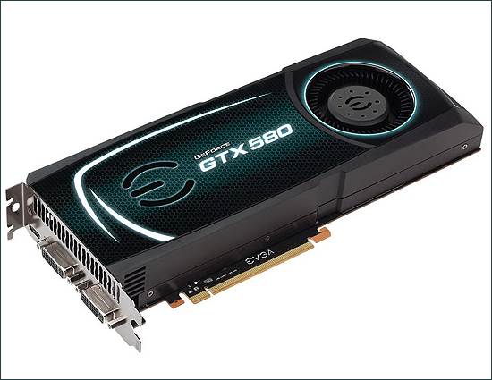
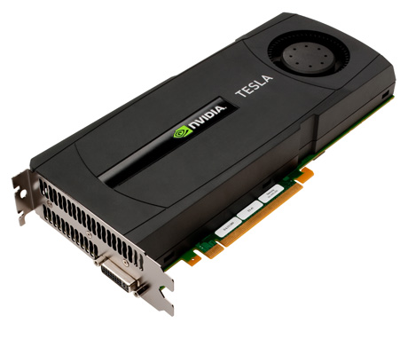
Recent GPU cards

Slide 4
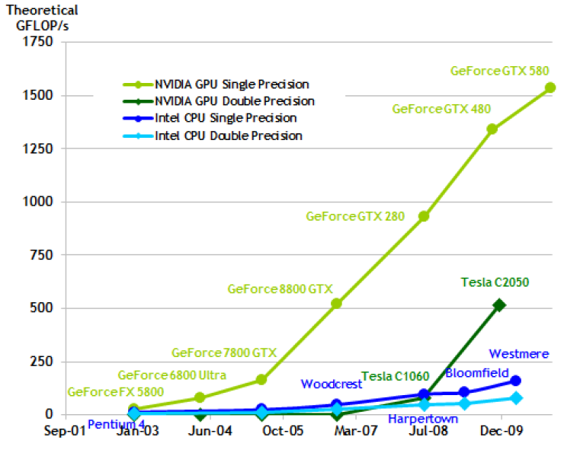
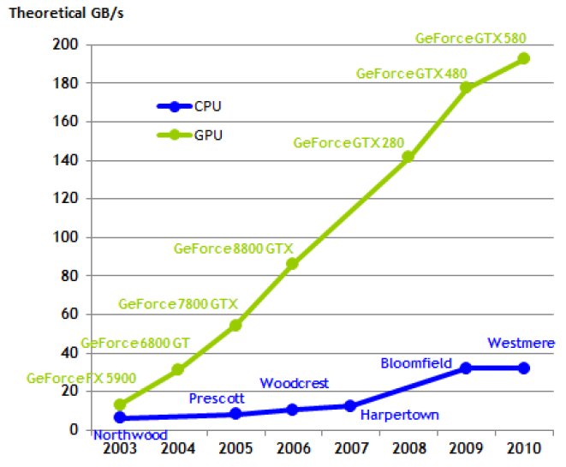
CPU vs. GPU

Slide 5
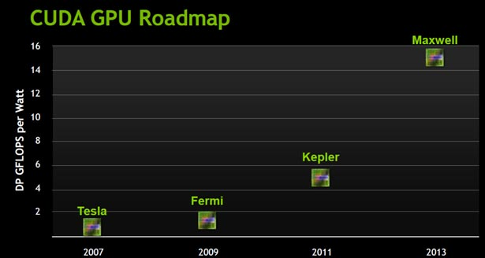
Tesla Roadmap

Slide 6
CUDA vs. open CL
CUDA (Compute Unified Device Architecture) by Nvidia
Open CL (Computing Language) by Khronos

Slide 7
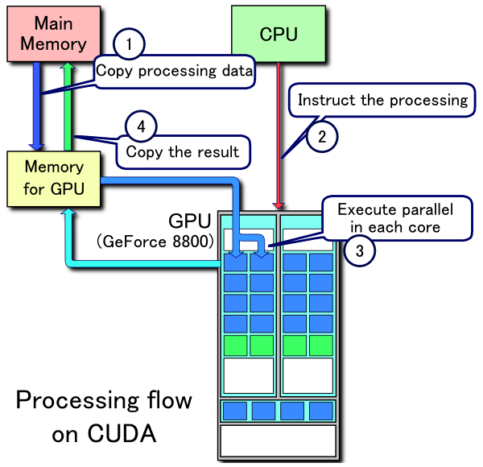
Processing flow
Bottlenecks
  PCI bus: 8GB/s
  Memory latency:
  400-800 clock cycles
  Memory BW:
  192.4 GB/s for
  Geforce 580

Slide 8
Access to a KIAS GPU cluster
From outside of the KIAS
  ssh cac@newton.kias.re.kr pw:cac!KIAS)
From inside of the KIAS or newton
  ssh guest@gpu.kias.re.kr pw:kias!guest
ssh gpu[01-24]
mkdir (your usual userid)
cd userid
cp –r ~jskim/exam_programs .

Slide 9
Example 1: Hello world
#include <stdio.h>
void hello_world(void) {
printf(“Hello World\n”);
}
int main (void) {
hello_world();
return 0;
}

Slide 10
Example 1: Hello world
#include <stdio.h>
__global__ void hello_world(void) {
printf(“Hello World\n”);
}
int main (void) {
hello_world<<<1,5>>>();
cudaThreadExit();
return 0;
}

Slide 11
Compile and Run
nvcc –arch sm_20 hello.cu
./a.out
  Hello World
  Hello World
  Hello World
  Hello World
  Hello World

Slide 12
C Language Extensions
Function Type Qualifiers
  __global__
    executed on the device (GPU)
    callable from the host (CPU) only
    functions should have void return type
    any call to a __global__ function must specify the
    execution configuration for that call

Slide 13
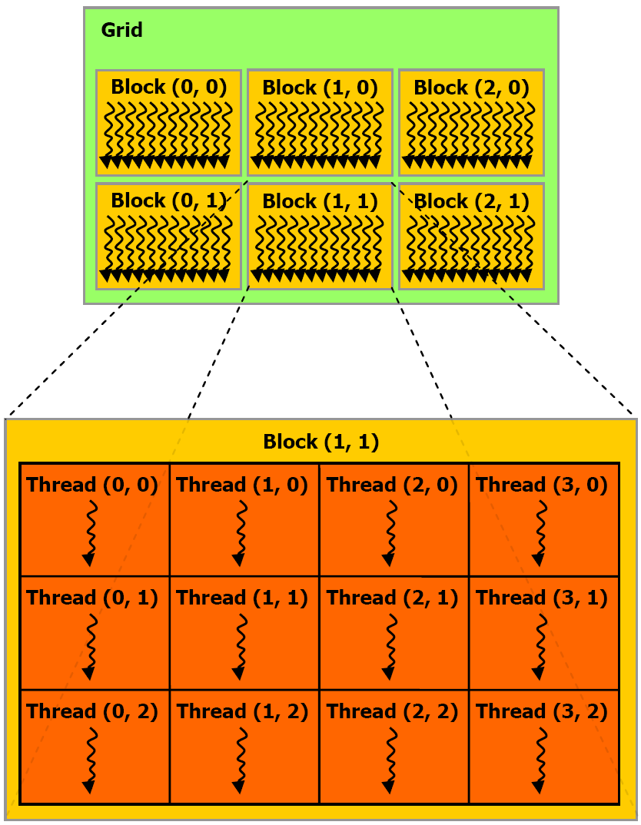
Grid, Block, Thread
Tesla S2050, Geforce 580
  max. block size of each
  Dim per grid
  65535x65535x1
  max. thread size of
  each Dim per block
  1024x1024x64
  max. # of threads per block
  1024

Slide 14
DeviceQuery
ls /usr/local/cuda/C/bin/linux/release/
/usr/local/cuda/C/bin/linux/release/deviceQuery
/usr/local/cuda/C/bin/linux/release/bandwidthTest

Slide 15
C Language Extensions
Execution configuration
  <<<blocksPerGrid,threadsPerBlock>>>
  <<<1,1>>>
  <<<65535,1024>
  dim3 blocksPerGrid(65535,65535,1)
  dim3 threadsPerBlock(1024,1,1)
  <<<blocksPerGrid,threadsPerBlock>>>

Slide 16
C Language Extensions
Built-in Variables
  blockIdx = (blockIdx.x, blockIdx.y, blockIdx.y)
  three unsigned integers, uint3
  threadIdx = (threadIdx.x, threadIdx.y, threadIdx.y)
  three unsigned integers, uint3
Built-in Vector types
  dim3:
    Integer vector type based on unit3
    used to specify dimensions

Slide 17
#include <stdio.h>
__global__ void exec_conf(void) {
int ix = threadIdx.x + blockIdx.x * blockDim.x;
printf("gridDim = (%d,%d,%d), blockDim = (%d,%d,%d)\n",
gridDim.x,gridDim.y,gridDim.z,
blockDim.x,blockDim.y,blockDim.z);
printf("blockIdx = (%d,%d,%d), threadIdx = (%d,%d,%d), arrayIdx %d\n",
blockIdx.x,blockIdx.y,blockIdx.z,
threadIdx.x,threadIdx.y,threadIdx.z, ix);
}
int main (void) {
exec_conf<<<2,3>>>();
cudaThreadExit();
return 0;
}

Slide 18
Compile and Run
nvcc –arch sm_20 exec_conf_1d.cu
./a.out
gridDim = (2,1,1), blockDim = (3,1,1)
gridDim = (2,1,1), blockDim = (3,1,1)
gridDim = (2,1,1), blockDim = (3,1,1)
gridDim = (2,1,1), blockDim = (3,1,1)
gridDim = (2,1,1), blockDim = (3,1,1)
gridDim = (2,1,1), blockDim = (3,1,1)
blockIdx = (0,0,0), threadIdx = (0,0,0), arrayIdx = 0
blockIdx = (0,0,0), threadIdx = (1,0,0), arrayIdx = 1
blockIdx = (0,0,0), threadIdx = (2,0,0), arrayIdx = 2
blockIdx = (1,0,0), threadIdx = (0,0,0), arrayIdx = 3
blockIdx = (1,0,0), threadIdx = (1,0,0), arrayIdx = 4
blockIdx = (1,0,0), threadIdx = (2,0,0), arrayIdx = 5

Slide 19
#include <stdio.h>
__global__ void exec_conf(void) {
int ix = threadIdx.x + blockIdx.x * blockDim.x;
int iy = threadIdx.y + blockIdx.y * blockDim.y;
printf("gridDim = (%d,%d,%d), blockDim = (%d,%d,%d)\n",
gridDim.x,gridDim.y,gridDim.z,
blockDim.x,blockDim.y,blockDim.z);
printf("blockIdx = (%d,%d,%d), threadIdx = (%d,%d,%d), arrayIdx=(%d,%d)\n",
blockIdx.x,blockIdx.y,blockIdx.z,
threadIdx.x,threadIdx.y,threadIdx.z, ix,iy);
}
int main (void) {
dim3 blocks(2,2,1);
dim3 threads(2,2,2);
exec_conf<<<blocks,threads>>>();
cudaThreadExit();
return 0;
}

Slide 21
Example 3: Vector sum
#include <stdio.h>
const int N=128;
void add(int *a, int *b, int *c) {
for (int i=0; i<N; i++) {
c[i] = a[i] + b[i];
}
}

Slide 22
Example 3: Vector sum
int main (void) {
int a[N], b[N], c[N];
for (int i=0; i<N; i++) {
a[i] = -i;
b[i] = i * i;
}
add (a, b, c);
for (int i=0; i<N; i++) {
printf("%d + %d = %d\n", a[i],b[i],c[i]);
}
return 0;
}

Slide 23
Example 3: Vector sum
#include <stdio.h>
const int N=10;
__global__ void add(int *a, int *b, int *c) {
int tid = threadIdx.x;
c[tid] = a[tid] + b[tid];
// tid += blcokDim.x * gridDim.x
}

Slide 24
Example 3: vector sum
int main (void) {
int a[N], b[N], c[N];
int *dev_a, *dev_b, *dev_c;
cudaMalloc( (void**)&dev_a, N * sizeof(int) );
cudaMalloc( (void**)&dev_b, N * sizeof(int) );
cudaMalloc( (void**)&dev_c, N * sizeof(int) );
for (int i=0; i<N; i++) {
a[i] = -i; b[i] = i * i;
}
cudaMemcpy ( dev_a, a, N * sizeof(int), cudaMemcpyHostToDevice );
cudaMemcpy ( dev_b, b, N * sizeof(int), cudaMemcpyHostToDevice );

Slide 25
Example 3: vector sum
add<<<1,N>>>(dev_a, dev_b, dev_c);
// add<<<N,1>>>(dev_a, dev_b, dev_c);
// add<<<128,128>>>(dev_a, dev_b, dev_c);
cudaMemcpy(c, dev_c, N * sizeof(int),cudaMemcpyDeviceToHost );
for (int i=0; i<N; i++) {
printf("%d + %d = %d\n", a[i],b[i],c[i]);
}
cudaFree (dev_a); cudaFree (dev_b); cudaFree (dev_c);
return 0;
}

Slide 26
Compile and Run
nvcc vector_sum_thread.cu
./a.out
0 + 0 = 0
-1 + 1 = 0
-2 + 4 = 2
-3 + 9 = 6
-4 + 16 = 12
-5 + 25 = 20
-6 + 36 = 30
-7 + 49 = 42
-8 + 64 = 56
-9 + 81 = 72

Slide 27
Device Memory Space

Slide 28
Exam: Dot Product
#include <stdio.h>
#define sum_squares(x) (x*(x+1)*(2*x+1)/6)
const int N = 2048;
float dot_product(float *a, float *b) {
float c = 0.0f;
for (int i=0; i<N; i++)
c += a[i]*b[i];
return c;
}

Slide 29
int main (void) {
float a[N], b[N];
for (int i=0; i<N; i++) {
a[i] = (float) i;
b[i] = (float) i;
}
float c = dot_product(a,b);
printf("Dot prodoct of a and b = %f\n", c);
printf("sum_squares of (N-1) = %f\n",
sum_squares((float)(N-1)) );
return 0;
}

Slide 30
#include <stdio.h>
#define imin(a,b) (a<b?a:b)
#define sum_squares(x) (x*(x+1)*(2*x+1)/6)
const int N = 2048;
const int threadsPerBlock = 256;
const int blocksPerGrid = 4;
__global__ void dot_product(float *a, float *b, float *c) {
__shared__ float cache[threadsPerBlock];
int tid = threadIdx.x + blockIdx.x * blockDim.x;
int cacheIndex = threadIdx.x;
float temp = a[tid] * b[tid];
cache[cacheIndex] = temp;
__syncthreads();

Slide 31
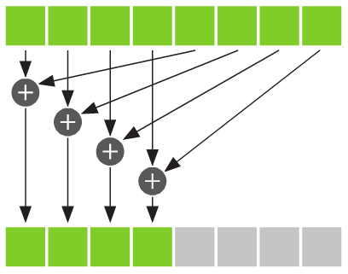
Reduction

Slide 32
int i = blockDim.x/2;
while (i != 0) {
if (cacheIndex < i)
cache[cacheIndex] += cache[cacheIndex + i];
__syncthreads();
i /= 2;
}
if (cacheIndex ==0)
c[blockIdx.x] = cache[0];

Slide 33
for (int i=0; i<N; i++) {
a[i] = (float) i;
b[i] = (float) i;
}
cudaMemcpy ( dev_a, a, N*sizeof(float), cudaMemcpyHostToDevice );
cudaMemcpy ( dev_b, b, N*sizeof(float), cudaMemcpyHostToDevice );
dot_product<<<blocksPerGrid,threadsPerBlock>>>(dev_a,dev_b,dev_partial_c);
cudaMemcpy ( partial_c, dev_partial_c, blocksPerGrid*sizeof(float), cudaMemcpyDeviceToHost );

Slide 34
c = 0.0f;
for (int i=0; i<blocksPerGrid; i++)
c += partial_c[i];
printf("Dot prodoct of a and b = %f\n", c);
printf("sum_squares of (N-1) = %f\n", sum_squares((float)(N-1)) );
// free memory on the CPU side
free(a); free(b); free(partial_c);
// free memory on the GPU side
cudaFree(dev_a); cudaFree(dev_b); cudaFree(dev_partial_c);
return 0;
}

Slide 35
#include <stdio.h>
#include <stdlib.h> // rand() function
#include <time.h> // for the clock() function
const long SIZE = 100*1024*1024;
int main (void) {
unsigned char buffer[SIZE];
unsigned int histo[256];
for (int i=0; i<SIZE; i++)
buffer[i] = rand()%256;

Slide 36
Histogram

Slide 37
double etime = (double) clock(); // start to measure the elapsed time
for (int i=0; i<256; i++)
histo[i] = 0;
for (int i=0; i<SIZE; i++)
histo[buffer[i]]++;
etime = ((double) clock() - etime)/(double)CLOCKS_PER_SEC ;
printf("elapsed time in seconds = %f\n",etime);
long histoCount = 0;
for (int i=0; i<256; i++)
histoCount += histo[i];
printf ("SIZE: %ld\n", SIZE);
printf ("Histogram Sum: %ld\n", histoCount);
return 0;
}

Slide 38
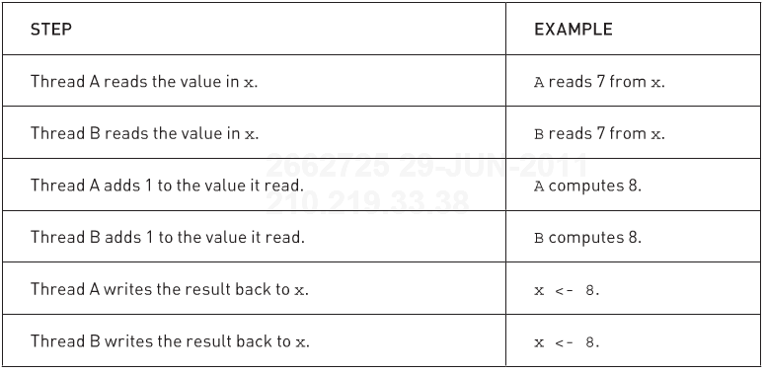
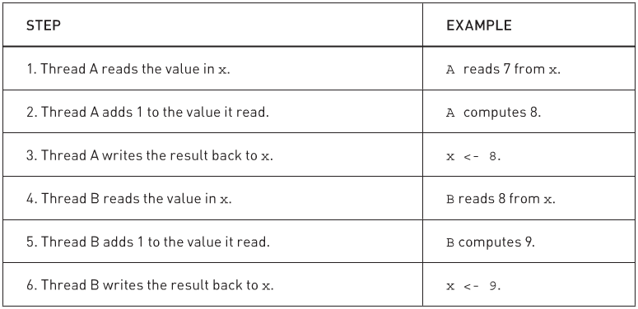
Read-modify- write

Slide 39
#include <stdio.h>
#include <stdlib.h> // rand() function
const long SIZE = 100*1024*1024;
const int threads = 256;
const int blocks = 128;
__global__ void histo_kernel(unsigned char *buffer, unsigned int *histo) {
int i = threadIdx.x + blockIdx.x * blockDim.x;
while (i < SIZE) {
atomicAdd ( &(histo[buffer[i]]), 1 );
i += blockDim.x * gridDim.x;
}
}

Slide 40
int main (void) {
unsigned char buffer[SIZE];
for (int i=0; i<SIZE; i++)
buffer[i] = rand()%256;
cudaEvent_t start, stop;
cudaEventCreate( &start );
cudaEventCreate( &stop );
cudaEventRecord( start,0 );
// allocate memory on the GPU
unsigned char *dev_buffer;
unsigned int *dev_histo;
cudaMalloc( (void**)&dev_buffer, SIZE);
cudaMemcpy( dev_buffer, buffer, SIZE, cudaMemcpyHostToDevice );
cudaMalloc( (void**)&dev_histo, 256*sizeof(int) );
cudaMemset( dev_histo, 0, 256*sizeof(int) );

Slide 41
histo_kernel<<<blocks,threads>>>(dev_buffer, dev_histo);
unsigned int histo[256];
cudaMemcpy( histo, dev_histo, 256*sizeof(int), cudaMemcpyDeviceToHost);
cudaEventRecord(stop, 0);
cudaEventSynchronize(stop);
float elapsedTime;
cudaEventElapsedTime( &elapsedTime, start, stop );
printf("elapsed time in seconds: %f\n", elapsedTime/1000.0 );

Slide 42
long histoCount = 0;
for (int i=0; i<256; i++)
histoCount += histo[i];
printf("SIZE: %ld\n", SIZE);
printf("Histogram Sum: %ld\n", histoCount);
for (int i=0; i<SIZE; i++)
histo[buffer[i]]--;
for (int i=0; i<256; i++)
if (histo[i] !=0)
printf( "Failure at %d!\n", i );
cudaEventDestroy( start );
cudaEventDestroy( stop );
cudaFree( dev_histo );
cudaFree( dev_buffer );
return 0;
}

Slide 43
Correlation Theorem
F-step (FT):
~log₂(N_{c}) operations per sample
X-step (CMAC):
~ N operations per sample

Slide 44
AI (Arithmetic Intensity)
Definition: number of operations (flops) per byte
AI for a[N]+b[N]
N flops / 8N bytes = 1/8
AI for A[N][N] * B[N][N]
2N³ flops/ 8N² bytes = N/4
If AI ~ 1, performance = AI x memory BW
If AI >~ 40(2.x),15(1.x), can the hide latency of global memory → better performance

Slide 45
AI for software correlation
AI = 8flops/16bytes (R_{i},R_{j}) = 0.5
AI = 32 flops/32bytes (R_{i}, L_{i}, R_{j}, L_{j}) = 1.0
for 1x1 tile
AI = 2.4 for 3x2 tiles
Since AIs are small numbers, correlation calculations are bounded by the memory bandwidth.
Performance: AI x memory BW (=102GB/s for Tesla C1060)

Slide 46
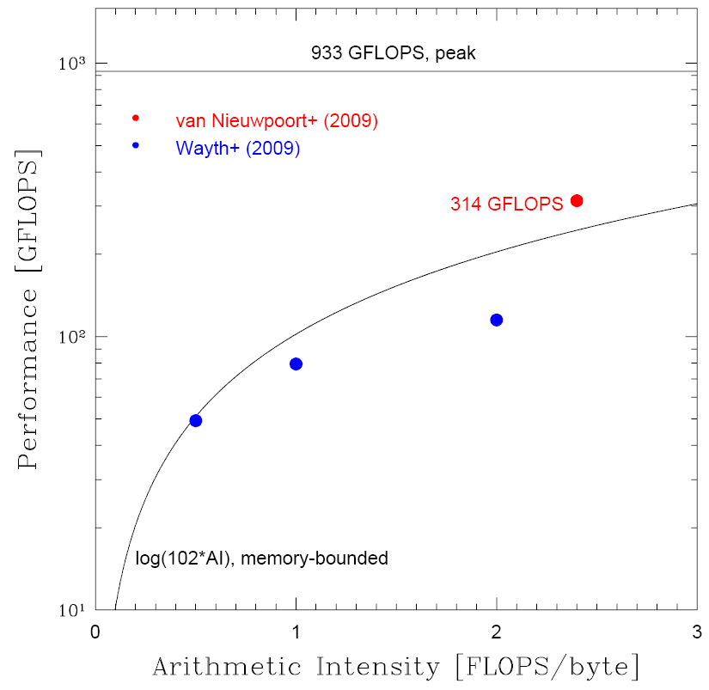
Performance of Tesla C1060 for software correlation
Performance is
memory-bounded.
Maximum
performance is
about 1/3 of the
peak performance.

Slide 47
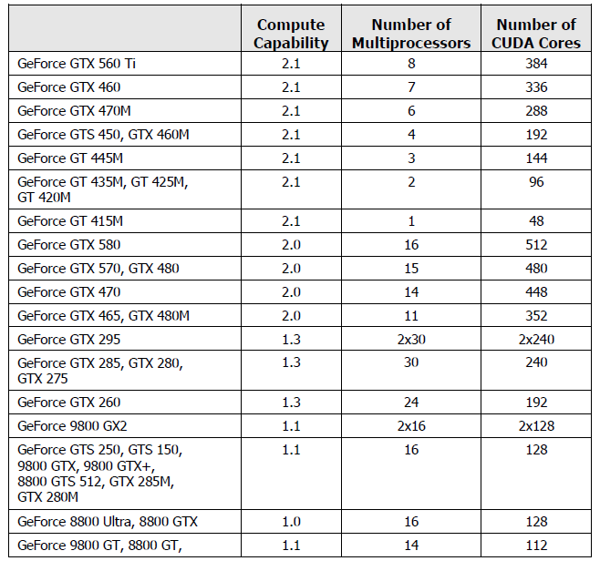
CUDA-Enabled Devices

Slide 48
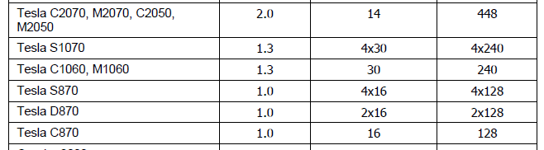
CUDA-Enabled Devices

Slide 49
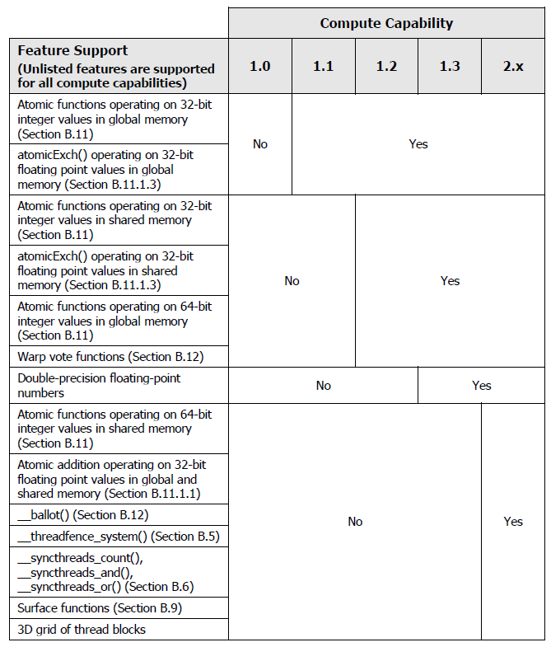
Compute Capability

Slide 50
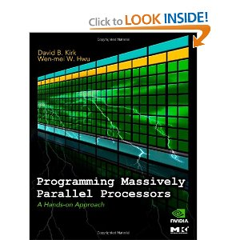

Cuda Books

Slide 51
Useful information
http://developer.nvidia.com
CUDA toolkit 4.0
Linux Getting Started Guide (installation)
CUDA C programming Guide

