Slide 1
Introduction to MPI
이 홍 석
(hsyi@kisti.re.kr)
한국과학기술정보연구원

Slide 2
Agenda
What is MPI?
  How to write a parallel program in MPI
  Basic MPI
  Point-to-point communication
Slightly more intermediated topics:
  Non-blocking communication in MPI
  Collective communication in MPI
Summary

Slide 3
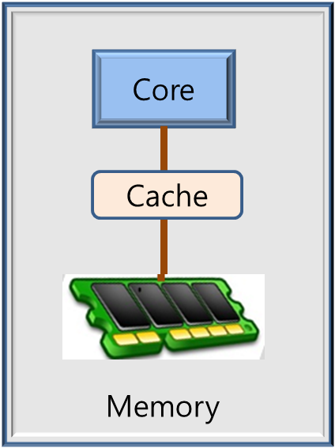
Single Processor System
Processor
  Core
  Cache
  Main Memory

Slide 4
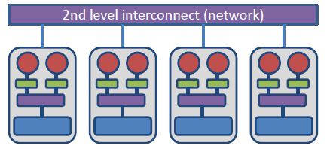
Distributed-Memory Parallelism
core
bus
Memory

Slide 5

Parallel Programming Paradigm
Message Passing Interface
Processes
Processor
Processor
MPI
Memory
Memory
Communication Network

Slide 6
A Message-Passing Program
if ( rank== 0 ) then k = k + 12
Process 0
Process 1
k: 18
k: 19
rank: 0
rank: 1
k: 30
k: 19

Slide 7
The Message-Passing Model (Example)
Counting 3s
4
1
5
3
6
1
0
8
3
9
3
3
P0
P1
P2
4
1
5
3
6
1
0
8
3
9
3
3
1
0
3
4

Slide 8
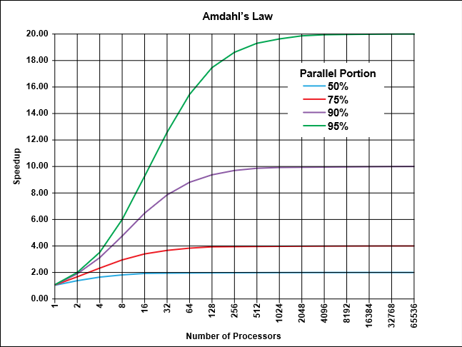
Parallelization: Amdahl’s Law

Slide 9
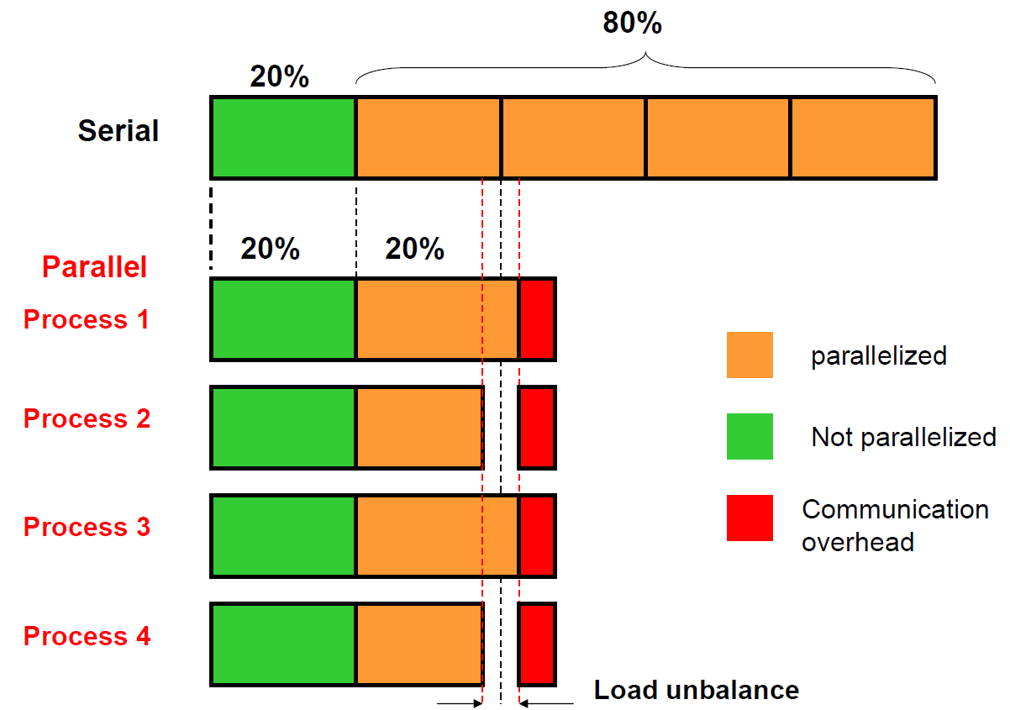
What is parallelization?

Slide 10
Basic guidance for parallelization
Increase the fraction of your program that can be parallelized
Balance the workload and parallel processes
  Block, cyclic, cyclic-block
Minimize time spent in communication

Slide 11
Bandwidth and latency
Communication time = Latency + MessageSize/Bandwidth
Communication
time
Latency
Message Size

Slide 12
Distributed Memory System
컴퓨팅성능
Exaflops
(Japan ?)
10¹⁸
China
(Tinahe2)
Japan (K)
이기종 컴퓨팅
10¹⁵
10¹²
클러스터 컴퓨팅
10⁹
벡터 컴퓨팅
10⁶
10³
1970
1980
1990
2000
2010
2020
2030
(년도)
MPI + ?

Slide 13
What is MPI?
Message Passing Interface
  MPI is a library, not a language, for inter-process communication and data exchange
  Use for Distributed Memory, Shared Memory
  MPI is portable
MPI History
  MPI-1 Standard (MPI Forum) : 1994
  MPI-2 Announce : 1997
  MPI-3 Announce : 2012

Slide 14

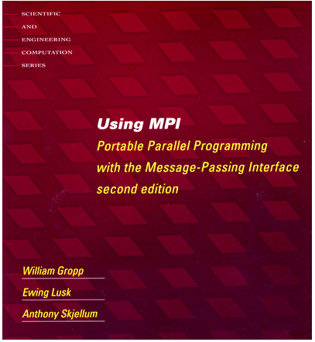

More information and documentation
The MPI Forum document archive
  http://www.mpi-forum.org/docs/
Other information on Web
  RWTH AACHEN University (http://www.rz.rwth-aachen.de/mpi/)
MPI Books

Slide 15
Six Functions for Simplified MPI
Six functions
  MPI_INIT
  MPI_COMM_SIZE
  MPI_COMM_RANK
  MPI_SEND
  MPI_RECV
  MPI_FINALIZE

Slide 16
Simple MPI program : C
#include <stdio.h>
#include <mpi.h>
int main (int argc, char *argv[])
{
int myrank, nprocs;
MPI_Init(&argc, &argv);
MPI_Comm_rank(MPI_COMM_WORLD, &myrank);
MPI_Comm_size(MPI_COMM_WORLD, &nprocs);
printf(" myrank: %d and nprocs: %d\n", myrank, nprocs);
MPI_Finalize();
return 0;
}
Basic
requirements
for an MPI
program
$mpicc -o a.out myrank.c
$mpirun -np 4 ./a.out

Slide 17
Simple MPI program : Fortran
PROGRAM hello
IMPLICIT NONE
INCLUDE 'mpif.h'
INTEGER myrank, nprocs, ierr
CALL MPI_Init(ierr)
CALL MPI_Comm_size(MPI_COMM_WORLD, nprocs, ierr)
CALL MPI_Comm_rank(MPI_COMM_WORLD, myrank, ierr)
WRITE (*, *) 'myrank:',myrank, 'and nprocs=', nprocs
CALL MPI_FINALIZE(ierr)
END PROGRAM hello
myrank: 1 and nprocs= 4
myrank: 2 and nprocs= 4
myrank: 3 and nprocs= 4
myrank: 0 and nprocs= 4
mpif90 -o a.out myrank.f90
mpirun -np 4 ./a.out

Slide 18
MPI Communicator
MPI_COMM_WORLD
mpirun –np 8 ./a.out
nprocs=8
myrank=0~7
0
1
7
2
3
4
5
6
myrank

Slide 19
MPI_Send
MPI_Send(buf, count, datatype, dest, tag, comm, status)
  ‘buf’
  ‘count’
  ‘datatype’
  ‘dest’
  ‘tag’
  ‘comm’
  ’status’

Slide 20
MPI_Recv
MPI_Recv(buf, count, datatype, source, tag, comm, status)
  ‘buf’
  ‘count’
  ‘datatype’
  ‘source’
  ‘tag’
  ‘comm’
  ’status’

Slide 21
MPI Message and Tag
Array
4
1
5
3
buf = array a[]
count = 4
datatype = int (8 byte for DP)
dest = rank(5)
tag = 0
comm= MPI_COMM_WORLD
7
0
1
Array
2
4
3
5
6

Slide 22
MPI Data Types (C)
MPI Data Type | C Data Type
MPI_CHAR – 1 Byte character | signed char
MPI_SHORT – 2 Byte integer | signed short int
MPI_INT – 4 Byte integer | signed int
MPI_LONG – 4 Byte integer | signed long int
MPI_UNSIGNED_CHAR – 1 Byte u char | unsigned char
MPI_UNSIGNED_SHORT – 2 Byte u int | unsigned short int
MPI_UNSIGNED – 4 Byte u int | unsigned int
MPI_UNSIGNED_LONG– 4 Byte u int | unsigned long int
MPI_FLOAT – 4 Byte float point | float
MPI_DOUBLE – 8 Byte float point | double
MPI_LONG_DOUBLE- 8 Byte float point | long double

Slide 23
MPI Data Types (Fortran)
MPI Data Type | Fortran Data Type
MPI_INTEGER – 4 Byte Integer | INTEGER
MPI_REAL – 4 Byte floating point | REAL
MPI_DOUBLE_PRECISION – 8 Byte | DOUBLE PRECISION
MPI_COMPLEX – 4 Byte float real | COMPLEX
MPI_LOGICAL – 4 Byte logical | LOGICAL
MPI_CHARACTER – 1 Byte character | CHARACTER(1)
2345
654
96574
-12
7676
count=5 INTEGER arr(5)
datatype=MPI_INTEGER
Notes:
MPI_INTEGER 4
MPI_REAL 4byte
MPI_DOUBLE_PRECISION 8bype

Slide 24
Simple Communication in MPI : C
/* Example name : pingpong */
int main(int argc, char *argv[])
{
int myrank, nprocs, tag = 55, root = 0;
int send = -1, recv = -1;
MPI_Status status;
MPI_Init(&argc, &argv);
MPI_Comm_size(MPI_COMM_WORLD, &nprocs);
MPI_Comm_rank(MPI_COMM_WORLD, &myrank);
if (myrank == root) {
printf("Before : myrank(%d) send = %d, recv = %d\n", myrank, send, recv);
send = rank + 7;
MPI_Send(&send, 1, MPI_INTEGER, 1, tag, MPI_COMM_WORLD);
}
else {
MPI_Recv(&recv, 1, MPI_INTEGER, root, tag, MPI_COMM_WORLD, &status);
printf("After : myrank(%d) send = %d, recv = %d\n", myrank, send, recv);
}
MPI_Finalize();
return 0;
}
Before : myrank(0) send = -1, recv = -1
After : myrank(1) send = -1, recv = 7

Slide 25
Simple Communication in MPI : Fortran
! Example name : p2p.f90
PROGRAM P2P
IMPLICIT NONE
INCLUDE 'mpif.h'
INTEGER myrank, nprocs, ierr, status(MPI_STATUS_SIZE)
INTEGER :: tag = 55, ROOT = 0
INTEGER :: send = -1, recv = -1
CALL MPI_INIT(ierr)
CALL MPI_COMM_SIZE(MPI_COMM_WORLD, nprocs, ierr)
CALL MPI_COMM_RANK(MPI_COMM_WORLD, myrank, ierr)
IF (myrank == ROOT) THEN
PRINT *, 'Before : myrank = ', myrank, ‘send = ', send, 'recv = ', recv
send = 7
CALL MPI_SEND(send,1,MPI_INTEGER,1,tag, MPI_COMM_WORLD, ierr)
ELSE
CALL MPI_RECV(recv, 1, MPI_INTEGER,ROOT,tag, MPI_COMM_WORLD, status, ierr)
PRINT *, 'After : myrank = ', myrank, 'send = ',send, 'recv = ', recv
END IF
CALL MPI_FINALIZE(ierr)
END PROGRAM P2P

Slide 26
Blocking Communication
MPI_SEND/MPI_RECV are blocking communication
  Only return from the MPI procedure call when the operation (whether it’s send or receive) has completed
Times
Beep!

Slide 27
Special Parameter Values
MPI_Recv(buf, count, datatype,source,tag, comm, status )
Info. | API
source | MPI_PROC_NULL | No sender, no operation takes place
source | MPI_ANY_SOURCE | Receive from any sender tag
tag | MPI_ANY_TAG | Receive messages with any tag
status | MPI_STATUS_IGNORE | Do not store any status data
comm | MPI_COMM_WORLD | Includes all processes
error | MPI_SUCCESS | Operation successful

Slide 28
Status object
  MPI_Get_count(MPI_Status *status, MPI_Datatype datatype, int *count)
Information | Fortran | C
source | status(MPI_SOURCE) | status.MPI_SOURCE
tag | status(MPI_TAG) | status.MPI_TAG
Error | Status(MPI_ERROR) | Status.MPI_ERROR
count | MPI_GET_COUNT() | MPI_Get_count()

Slide 29
Blocking Communication : Fortran
PROGRAM isend
INCLUDE 'mpif.h'
INTEGER err, rank, size, count
REAL data(100), value(200)
INTEGER status(MPI_STATUS_SIZE)
CALL MPI_INIT(err)
CALL MPI_COMM_RANK(MPI_COMM_WORLD,rank,err)
CALL MPI_COMM_SIZE(MPI_COMM_WORLD,size,err)
IF (rank.eq.0) THEN
data=3.0
CALL MPI_SEND(data,100,MPI_REAL,1,55,MPI_COMM_WORLD,err)
ELSEIF (rank .eq. 1) THEN
CALL MPI_RECV(value,200,MPI_REAL,MPI_ANY_SOURCE,55, &
MPI_COMM_WORLD,status,err)
PRINT *, "P:",rank," got data from processor ", &
status(MPI_SOURCE)
CALL MPI_GET_COUNT(status,MPI_REAL,count,err)
PRINT *, "P:",rank," got ",count," elements"
PRINT *, "P:",rank," value(5)=",value(5)
ENDIF
CALL MPI_FINALIZE(err)
END

Slide 30
Blocking Communication : C
#include <stdio.h>
#include <mpi.h>
void main(int argc, char *argv[]) {
int rank, i, count;
float data[100],value[200];
MPI_Status status;
MPI_Init(&argc,&argv);
MPI_Comm_rank(MPI_COMM_WORLD,&rank);
if(rank==1) {
for(i=0;i<100;++i) data[i]=i;
MPI_Send(data,100,MPI_FLOAT,0,55,MPI_COMM_WORLD);
}
else {
MPI_Recv(value,200,MPI_FLOAT,MPI_ANY_SOURCE,55,MPI_COMM_WORLD,&status);
printf("P:%d Got data from processor %d \n",rank, status.MPI_SOURCE);
MPI_Get_count(&status,MPI_FLOAT,&count);
printf("P:%d Got %d elements \n",rank,count);
printf("P:%d value[5]=%f \n",rank,value[5]);
}
MPI_Finalize();
}

Slide 31

Lab #1
Basic mpi

Slide 32
Lab01
Login system :
Copy MPI examples file to your home directory
  pwd
  cp –R mpiLab .
  Change sub-directory
  System info
    /proc/cpuinfo
    /proc/meminfo
    which mpirun

Slide 33
/* Lab01/basic_a.c
Written by Hongsuk Yi
Mon Jul 7 10:03:43 KST 2014
*/
#include<stdlib.h>
#include<mpi.h>
int main(int argc,char *argv[])
{
int rank, nprocs, len;
char name[MPI_MAX_PROCESSOR_NAME];
MPI_Init(&argc,&argv);
MPI_Comm_size(MPI_COMM_WORLD,&nprocs);
MPI_Comm_rank(MPI_COMM_WORLD,&rank);
MPI_Get_processor_name(name, &len);
printf("Hello World rank %d of %d on %s\n", rank, nprocs, name);
MPI_Finalize();
}
$mpicc basic_a.c
$mpirun -np 4 ./a.out
Hello World rank 1 of 4 on mainhost
Hello World rank 2 of 4 on mainhost
Hello World rank 3 of 4 on mainhost
Hello World rank 0 of 4 on mainhost

Slide 34
Basic MPI Send/Recv
Compile and Run
  mpicc –o a1.out 01_basic.c
  mpirun –np 4 a1.out
sbuf
rbuf
sbuf
rbuf
rbuf
sbuf
rbuf
sbuf
rank 0
rank 1
rank 2
rank 3
size=1024 sbuf[size] rbuf[size]

Slide 35
//basic_b.c
#include<stdio.h>
#include<mpi.h>
int main(int argc,char *argv[])
{
int i,rank, nprocs;
int size=1024;
int *sbuf, *rbuf;
MPI_Status status;
MPI_Init(&argc,&argv);
MPI_Comm_size(MPI_COMM_WORLD,&nprocs);
MPI_Comm_rank(MPI_COMM_WORLD,&rank);
sbuf = malloc(sizeof(int)*size);
rbuf = malloc(sizeof(int)*size);
for(i=0;i<size;i++) sbuf[i]=i+rank+8;
if (rank < nprocs-1){
MPI_Send(sbuf,size,MPI_INT,rank+1,rank+1,MPI_COMM_WORLD);
printf("Send:%4d sbuf:%8d Tag:%4d Recv: %4d\n",
rank,sbuf[0],rank+1,rank+1);
}
if (rank > 0){
MPI_Recv(rbuf,size,MPI_INT,rank-1,rank,MPI_COMM_WORLD,&status);
printf("Recv:%4d rbuf:%8d Tag:%4d Send: %4d\n",
rank,rbuf[0],rank,rank-1);
}
free(sbuf); free(rbuf);
MPI_Finalize();
}
sbuf
rbuf
sbuf
rbuf
rbuf
sbuf
rbuf
sbuf
rank 0
rank 1
rank 2
rank 3
mpirun -np 4 ./a.out -np 2 ./a.out
Send: 0 sbuf: 8 Tag: 1 Recv: 1
Send: 1 sbuf: 9 Tag: 2 Recv: 2
Recv: 1 rbuf: 8 Tag: 1 Send: 0
Send: 2 sbuf: 10 Tag: 3 Recv: 3
Recv: 2 rbuf: 9 Tag: 2 Send: 1
Recv: 3 rbuf: 10 Tag: 3 Send: 2

Slide 36
MPI_PROC_NULL; MPI_ANY_TAG
Compile and Run
  MPI_ANY_SOURCE, MPI_ANY_TAG (basic_c.c)
  MPI_PROC_NULL (05_basic.c)
sbuf
rbuf
sbuf
rbuf
rbuf
sbuf
rbuf
sbuf
rank 0
rank 1
rank 2
rank 3
size=1024 sbuf[size] rbuf[size]

Slide 37
/* Lab01/basic_c.c
Written by Hongsuk Yi (2014.07.07) */
int main(int argc,char *argv[]){
int i,rank, nprocs, size=1024;
int *sbuf, *rbuf, source,dest, count;
MPI_Status status;
MPI_Init(&argc,&argv);
MPI_Comm_size(MPI_COMM_WORLD,&nprocs);
MPI_Comm_rank(MPI_COMM_WORLD,&rank);
sbuf = malloc(sizeof(int)*size);
rbuf = malloc(sizeof(int)*size);
for(i=0;i<size;i++) sbuf[i]=i+rank+8;
if (rank < nprocs-1)
dest=rank+1;
else
dest=MPI_PROC_NULL;
if (rank > 0)
source=rank-1;
else
source=MPI_PROC_NULL;
MPI_Send(sbuf,size,MPI_INT,dest,rank+1,MPI_COMM_WORLD);
printf("Send:%4d sbuf:%8d Tag:%4d Recv: %4d\n",
rank,sbuf[0],rank+1,dest);
MPI_Recv(rbuf,size,MPI_INT,source,MPI_ANY_TAG,MPI_COMM_WORLD,&status);
MPI_Get_count(&status,MPI_INT,&count);
printf("Recv:%4d count:%8d Tag:%4d source: %4d\n",
rank,count,status.MPI_TAG,status.MPI_SOURCE);
MPI_Finalize();
}
mpirun -np 4 ./a.out -np 2 ./a.out -np 4 ./a.out
Send: 3 sbuf: 11 Tag: 4 Recv: -1
Send: 1 sbuf: 9 Tag: 2 Recv: 2
Send: 2 sbuf: 10 Tag: 3 Recv: 3
Recv: 3 count: 1024 Tag: 3 source: 2
Recv: 2 count: 1024 Tag: 2 source: 1
Send: 0 sbuf: 8 Tag: 1 Recv: 1
Recv: 1 count: 1024 Tag: 1 source: 0
Recv: 0 count: 0 Tag: -1 source: -1
sbuf
rbuf
sbuf
rbuf
rbuf
sbuf
rbuf
sbuf
rank 0
rank 1
rank 2
rank 3

Slide 38
Agenda
What is MPI?
  How to write a parallel program in MPI
  Basic MPI
  Point-to-point communication
Slightly more intermediated topics:
  Non-blocking communication in MPI
  Collective communication in MPI
  Lab2
Summary and final Q&A

Slide 39
Communication Mode
Mode | MPI Call Routine
 | Blocking | Non Blocking
Synchronous | MPI_SSEND | MPI_ISSEND
Ready | MPI_RSEND | MPI_IRSEND
Buffer | MPI_BSEND | MPI_IBSEND
Standard | MPI_SEND | MPI_ISEND
Recv | MPI_RECV | MPI_IRECV

Slide 40

(Blocking) Synchronous Send
MPI_SSEND
(blocking synchronous send)
data transfer
from source complete
Task Waits
Sender
Receiver
Waits
Receiving task waits
until buffer is filled
MPI_RECV

Slide 41

(Blocking) Ready Send
MPI_RSEND
(blocking ready send)
data transfer
from source complete
Sender
Receiver
Waits
Receiving task waits
until buffer is filled
MPI_RECV

Slide 42
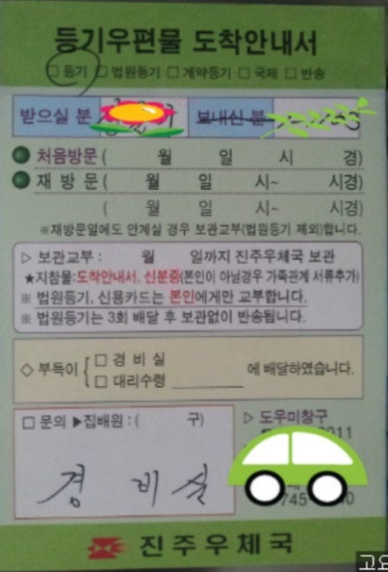
(Blocking) Buffered Send
MPI_BSEND
(blocking buffered send)
data transfer to user-supplied buffer complete
Waits
User-supplied buffer
Sender
Receiver
Waits
Receiving task waits
until buffer is filled
MPI_RECV
    MPI_Buffer_attach,
    MPI_Buffer_detach

Slide 43

(Blocking) Standard Send
CASE II : message size > threshold (~ kb) then takes Ssend mode
CASE I : message size < threshold (~ kb)
MPI_SEND
(blocking standard send)
data transfer to user-supplied buffer complete
Waits
Sender
Receiver
system buffer
on receiver
Task continues when
data transfer to user’s buffer
is complete
MPI_RECV

Slide 44
Wallclock Time
Wallclock time (real time, elapsed time)
  CPU, I/O, communication, and other jobs
  gettimeofday() — C/C++
    Resolution up to microseconds.
  MPI_Wtime() — C/C++/Fortran
    start = MPI_Wtime();
    <code to be timed>
    finish = MPI_Wtime();

Slide 45
MPI_Wtime()
startTime = MPI_Wtime();
for (icount=0; icount < Length; icount ++){
MPI_Send(myArray, nSend, MPI_INT, 1, 0, MPI_COMM_WORLD);
MPI_Probe(MPI_ANY_SOURCE, MPI_ANY_TAG, MPI_COMM_WORLD, &status);
MPI_Get_count(&status, MPI_INT, &nRecv);
MPI_Recv(myArray, nRecv, MPI_INT, 1, 0,
MPI_COMM_WORLD, MPI_STATUS_IGNORE);
}
endTime = MPI_Wtime();
mpirun -np 2 ./a.out
Rank 0: Received 00004096 elements, eTimes: 0.00222
Rank 0: Received 00008192 elements, eTimes: 0.00019
Rank 0: Received 00016384 elements, eTimes: 0.00028
Rank 0: Received 00032768 elements, eTimes: 0.00049
Rank 0: Received 00065536 elements, eTimes: 0.00090
Rank 0: Received 00131072 elements, eTimes: 0.00165

Slide 46
Lab #2
Deadlock

Slide 47
Blocking routines and Deadlocks
Blocking routines
  Completion depends on other processes
  Risk for deadlocks
    the program is stuck forever
  MPI_Send exits once the send buffer can be safely read and written to
  MPI_Recv exits once it has received the message in the receive buffer

Slide 48
Deadlock
All of the sends may block, waiting for a matching receive (will for large enough messages)
MPI_SEND
Task Waits
Process 0
Process 1
MPI_Send

Slide 49
/* Lab02/deadlock.c Written by Hongsuk Yi (2014.07.07) */
int main(int argc, char *argv[]){
int nprocs, rank, i,count;
int nSize=1000;
MPI_Status status;
double sbuf[nSize], rbuf[nSize];
MPI_Init(&argc, &argv);
MPI_Comm_size(MPI_COMM_WORLD, &nprocs);
MPI_Comm_rank(MPI_COMM_WORLD, &rank);
if (nprocs < 2){
printf("Error: Run the program with at least 2 tasks!\n");
MPI_Abort(MPI_COMM_WORLD, 1);
}
for (i=0; i<nSize; i++) {
sbuf[i] = rank; rbuf[i] = rank*3.;
}
if (rank == 0) {
MPI_Send(sbuf, nSize, MPI_DOUBLE, 1, 17, MPI_COMM_WORLD);
MPI_Recv(rbuf, nSize, MPI_DOUBLE, 1, 19, MPI_COMM_WORLD, &status);
printf("myrank=%d nSize=%6d rbuf[nSize-1]=%.3f \n",rank, nSize, rbuf[nSize-1]);
}
else if (rank == 1) {
MPI_Send(rbuf, nSize, MPI_DOUBLE, 0, 19, MPI_COMM_WORLD);
MPI_Recv(sbuf, nSize, MPI_DOUBLE, 0, 17, MPI_COMM_WORLD, &status);
MPI_Get_count(&status, MPI_BYTE, &count );
printf("myrank=%d rbuf[0]=%.3f recv. bytes=%8d \n",rank, rbuf[0],count);
}
MPI_Finalize();
}
mpirun -np 2 ./a.out
myrank=0 nSize= 5000 rbuf[nSize-1]=3.000
myrank=1 rbuf[0]=3.000 recv. bytes= 40000
sbuf[]; tag=17
sbuf
rbuf
rbuf
sbuf
rank 0
rank 1
sbuf[]; tag=19

Slide 50
Combined send & receive
Sends one message and receives another one, with one single command
  Reduces risk for deadlocks
  MPI_Sendrecv
    Useful in shift operations
    Equivalent to: execute a nonblocking send and a nonblocking recv, and then wait for them to complete
  MPI_PROC_NULL
    Any communication returns immediately with no effect but as if the operation has been successful

Slide 51
MPI_Sendrecv
int MPI_Sendrecv(void *sbuf, int sendcount, MPI_Datatype sendtype,
int dest, int sendtag,
void *rbuf, int recvcount, MPI_Datatype recvtype,
int source, int recvtag, MPI_Comm comm, MPI_Status *status)
MPI_SENDRECV(SENDBUF, SENDCOUNT, SENDTYPE,
DEST, SENDTAG, RECVBUF, RECVCOUNT, RECVTYPE,
SOURCE, RECVTAG, COMM, STATUS, IERROR)
Example : C
MPI_Sendrecv(sbuf,size,MPI_INT,destination,rank+1, rbuf, size, MPI_INT, source,MPI_ANY_TAG,MPI_COMM_WORLD,&status);

Slide 52
Sendrecv Communication Patterns
Pairwise exchange
P0
P1
P2
P3
MPI_Send(data,right); MPI_Recv(data,left)
MPI_Send(data,left); MPI_Recv(data,right)
Pipe, a ring of processes exchanging data
P0
P1
P2
P3

Slide 53
/* Lab02/sendrecv_a.c Written by Hongsuk Yi (2014.07.07)*/
int main(int argc,char *argv[]){
int i,rank, nprocs, nSize=1000,source,dest, count;
double *sbuf, *rbuf;
MPI_Status status;
MPI_Init(&argc,&argv);
MPI_Comm_size(MPI_COMM_WORLD,&nprocs);
MPI_Comm_rank(MPI_COMM_WORLD,&rank);
sbuf = malloc(sizeof(double)*nSize);
rbuf = malloc(sizeof(double)*nSize);
for(i=0;i<nSize;i++)
for (i=0; i<nSize; i++) {
sbuf[i] = rank; rbuf[i] = -100.0;
}
if (rank < nprocs-1)
dest=rank+1;
else
dest=MPI_PROC_NULL;
if (rank > 0)
source=rank-1;
else
source=MPI_PROC_NULL;
MPI_Sendrecv(sbuf,nSize,MPI_DOUBLE,dest,rank+1,
rbuf,nSize,MPI_DOUBLE,source,MPI_ANY_TAG, MPI_COMM_WORLD,&status);
MPI_Get_count(&status,MPI_DOUBLE,&count);
printf("r=%d sbuf[0]=%5.1f rbuf[0]=%6.1f count=%6d tag=%2d src=%2d\n",
rank, sbuf[0],rbuf[0],count,status.MPI_TAG,status.MPI_SOURCE);
free(sbuf); free(rbuf);
MPI_Finalize();
}
mpirun -np 8 ./a.out
r=0 sbuf[0]= 0.0 rbuf[0]=-100.0 count= 0 tag=-1 src=-1
r=1 sbuf[0]= 1.0 rbuf[0]= 0.0 count= 1000 tag= 1 src= 0
r=2 sbuf[0]= 2.0 rbuf[0]= 1.0 count= 1000 tag= 2 src= 1
r=3 sbuf[0]= 3.0 rbuf[0]= 2.0 count= 1000 tag= 3 src= 2
r=4 sbuf[0]= 4.0 rbuf[0]= 3.0 count= 1000 tag= 4 src= 3
r=5 sbuf[0]= 5.0 rbuf[0]= 4.0 count= 1000 tag= 5 src= 4
r=6 sbuf[0]= 6.0 rbuf[0]= 5.0 count= 1000 tag= 6 src= 5
r=7 sbuf[0]= 7.0 rbuf[0]= 6.0 count= 1000 tag= 7 src= 6

Slide 54
/* Lab02/sendrecv_b.c Written by Hongsuk Yi (2014.07.07) */
#include<stdio.h>
#include<mpi.h>
int main(int argc,char *argv[]){
int i,rank, nprocs, nSize=1000, count, left, right;
double *sbuf, *rbuf;
MPI_Status status;
MPI_Init(&argc,&argv);
MPI_Comm_size(MPI_COMM_WORLD,&nprocs);
MPI_Comm_rank(MPI_COMM_WORLD,&rank);
sbuf = malloc(sizeof(double)*nSize);
rbuf = malloc(sizeof(double)*nSize);
for(i=0;i<nSize;i++)
for (i=0; i<nSize; i++) {
sbuf[i] = rank; rbuf[i] = -100.0;
}
left = (rank-1 + nprocs)%nprocs;
right = (rank+1)%nprocs;
MPI_Sendrecv(sbuf,nSize,MPI_DOUBLE,left,rank+1,
rbuf,nSize,MPI_DOUBLE,right,MPI_ANY_TAG, MPI_COMM_WORLD,&status);
MPI_Get_count(&status,MPI_DOUBLE,&count);
printf("r=%d sbuf[0]=%5.1f rbuf[0]=%6.1f count=%6d tag=%2d src=%2d\n",
rank, sbuf[0],rbuf[0],count,status.MPI_TAG,status.MPI_SOURCE);
free(sbuf); free(rbuf);
MPI_Finalize();
}
$mpirun -np 8 ./a.out
r=4 sbuf[0]= 4.0 rbuf[0]= 5.0 count= 1000 tag= 6 src= 5
r=6 sbuf[0]= 6.0 rbuf[0]= 7.0 count= 1000 tag= 8 src= 7
r=1 sbuf[0]= 1.0 rbuf[0]= 2.0 count= 1000 tag= 3 src= 2
r=2 sbuf[0]= 2.0 rbuf[0]= 3.0 count= 1000 tag= 4 src= 3
r=3 sbuf[0]= 3.0 rbuf[0]= 4.0 count= 1000 tag= 5 src= 4
r=5 sbuf[0]= 5.0 rbuf[0]= 6.0 count= 1000 tag= 7 src= 6
r=0 sbuf[0]= 0.0 rbuf[0]= 1.0 count= 1000 tag= 2 src= 1
r=7 sbuf[0]= 7.0 rbuf[0]= 0.0 count= 1000 tag= 1 src= 0

Slide 55
Lab #3
Parallel Sum

Slide 56
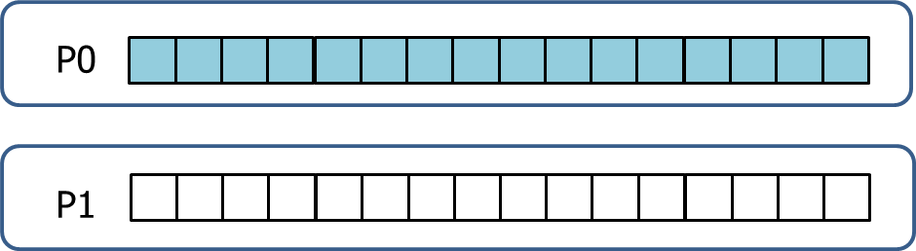
Parallel Sum
Array is originally on root process (P0)
Parallel algorithm
  Scatter (nprocs=2)
    Half of the array is sent to process P1
  Compute
    P0 & P1 sum independently their segment
  Reduction
    Partial sum on P1 sent to P0
P0
P1

Slide 57
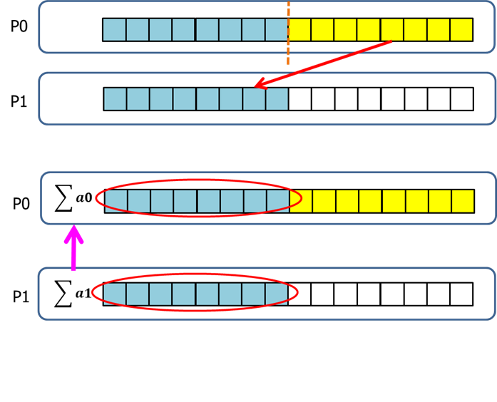
Parallel sum
Timeline
P0
P1
Send
Recv
Compute
Compute
P0 sums the partial sums

Slide 58
// psum_a.c
int main(int argc, char *argv[]){
int i,rank,nprocs N=1024, localN[2];
double *array, sum,psum;
MPI_Status status;
MPI_Init(&argc,&argv);
MPI_Comm_rank(MPI_COMM_WORLD,&rank);
MPI_Comm_size(MPI_COMM_WORLD,&nprocs);
localN[0]=N/2; localN[1]=N-N/2;
array=malloc(sizeof(double)*N);
if(rank==0)
for(i=0;i<N;i++) array[i]=1.0;
if(rank==0)
MPI_Send(&array[localN[0]],localN[1],MPI_DOUBLE,1,10,MPI_COMM_WORLD);
if(rank==1)
MPI_Recv(array,localN[1],MPI_DOUBLE,0,10,MPI_COMM_WORLD,&status);
psum=0;
for(i=0;i<localN[rank];i++)
psum+=array[i];
if(rank==0)
MPI_Recv(&sum,1,MPI_DOUBLE,1,11,MPI_COMM_WORLD,&status);
if(rank==1)
MPI_Send(&psum,1,MPI_DOUBLE,0,11,MPI_COMM_WORLD);
if (rank==0){
sum+=psum;
printf("Sum is %g, partial sum %g\n",sum,psum);
}
MPI_Finalize();
}
mpirun -np 2 ./a.out
Sum is 1024, partial sum 512

Slide 59
//weak scaling
//psum_b.c
int main(int argc, char *argv[]){
int i,rank,nprocs,N;
double *array;
double sum,psum;
int *localN;
MPI_Status status;
int startIndex;
MPI_Init(&argc,&argv);
MPI_Comm_rank(MPI_COMM_WORLD,&rank);
MPI_Comm_size(MPI_COMM_WORLD,&nprocs);
N=1024*nprocs;
localN=malloc(sizeof(int)*nprocs);
if(rank==0){
for(i=0;i<nprocs;i++)
localN[i]=N/nprocs;
for(i=0;i<N%nprocs;i++)
localN[i]++;
}
array=malloc(sizeof(double)*N);
if(rank==0){
for(i=0;i<N;i++)
array[i]=1.0;
}

Slide 60
if(rank==0) {
startIndex=localN[0];
for(i=1;i<nprocs;i++){
MPI_Send(&array[startIndex],localN[i],MPI_DOUBLE,i,10,MPI_COMM_WORLD);
startIndex+=localN[i];
}
}
else{
MPI_Recv(array,N,MPI_DOUBLE,0,MPI_ANY_TAG,MPI_COMM_WORLD,&status);
MPI_Get_count(&status,MPI_DOUBLE,&(localN[rank]));
}
psum=0;
for(i=0;i<localN[rank];i++){
psum+=array[i];
}
if(rank==0) {
sum=psum;
for(i=1;i<nprocs;i++){
MPI_Recv(&psum,1,MPI_DOUBLE,MPI_ANY_SOURCE,
MPI_ANY_TAG,MPI_COMM_WORLD,MPI_STATUS_IGNORE);
sum+=psum;
}
printf("Sum is %g\n",sum);
}
else
MPI_Send(&psum,1,MPI_DOUBLE,0,11,MPI_COMM_WORLD);
free(array); free(localN); MPI_Finalize();
}

Slide 61
Agenda
What is MPI?
  How to write a parallel program in MPI
  Basic MPI
  Point-to-point communication
Slightly more intermediated topics:
  Non-blocking communication in MPI
  Collective communication in MPI
  Lab2
Summary and final Q&A

Slide 62
Non-Blocking Communication
Return straight away and allow the sub-program to return to perform other work
Communication has three steps
  Initialization : Posting send or recv
  Perform other job
    Do communication and calculation at the same time
  Completion : Waiting or Testing
Easier to write dead-lock free code
Reduce communication overhead

Slide 63
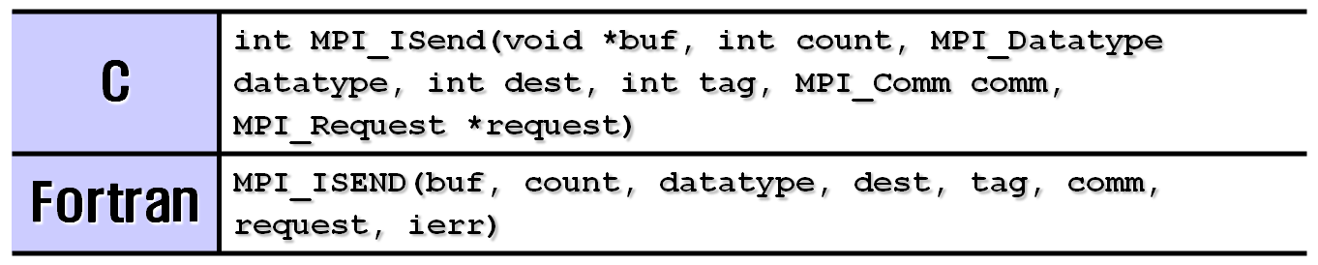

Non-Blocking’s Initialization
INTEGER request : communication request handle (OUT)
Non-blocking Irecv has no status argument

Slide 64
Non-blocking Send
Array
4
1
5
3
0: sender
7
Wait
0
1
Array
5: receiver
2
4
3
5
6
Send is initiated and returns straight away.
Sending process can do other things
Can test later whether operation has completed.

Slide 65
Completion
MPI_Wait or MPI_Test
  Process blocking until the communication is complete
  Non-blocking operations + Waiting = Blocking operation
    Use a pair of MPI_Isend/MPI_Wait or MPI_Irecv/MPI_Wait
C | int MPI_Wait(MPI_Request *request, MPI_Status *status)
Fortran | MPI_WAIT(request, status, ierr)
C | int MPI_Test(MPI_Request *request, int *flag, MPI_Status *status)
Fortran | MPI_TEST(request, flag, status, ierr)

Slide 66
(non-blocking) Standard Send
CASE I : message size < threshold (~ kb)
MPI_ISEND
(nonblocking standard send)
No delay even though message is not yet in user’s buffer on receiving node
MPI_WAIT
Sender
Receiver
MPI_WAIT
system buffer on receiver
No delay if MPI_WAIT is late enough
Transfer to buffer on receiving node
Can be avoided if
MPI_IRECV posted early enouth
MPI_IRECV

Slide 67
(non-blocking) Standard Send
CASE II : message size > threshold (~ kb)
MPI_ISEND
(nonblocking standard send)
MPI_WAIT
data transfer
from source complete
Task Waits
Sender
Receiver
MPI_WAIT
Transfer doesn’t begin until
Word has arrived that corresponding
MPI_IRECV has been posted
Receiving task waits
until buffer is filled
MPI_IRECV

Slide 68
int main(int argc, char *argv[]){
int nrank, nprocs, i;
float data[100], value[200];
MPI_Request req; MPI_Status status;
MPI_Init(&argc, &argv);
MPI_Comm_size(MPI_COMM_WORLD, &nprocs);
MPI_Comm_rank(MPI_COMM_WORLD, &nrank);
if (nrank == 1) {
for (i=0; i<100; i++)
data[i] = i;
MPI_Isend(data, 100, MPI_FLOAT, 0, 55, MPI_COMM_WORLD, &req);
MPI_Wait(&req, &status);
}
else if (nrank == 0){
for (i=0; i<200; i++)
value[i] = 0.0;
MPI_Irecv(value, 200, MPI_FLOAT, 1, 55, MPI_COMM_WORLD, &req);
MPI_Wait(&req, &status);
printf("rank(%d) value[5] = %f.\n", nrank, value[5]);
}
MPI_Finalize();
return 0;
}

Slide 69
Lab #4
Nonblocking

Slide 70
//nonblock.c
#include <stdlib.h>
#include <mpi.h>
int main(int argc, char **argv)
{
int rank, nprocs,tag,source,dest,count, buffer;
MPI_Status status;
MPI_Request req;
MPI_Init(&argc,&argv);
MPI_Comm_size(MPI_COMM_WORLD,&nprocs);
MPI_Comm_rank(MPI_COMM_WORLD,&rank);
tag=1234; source=0; dest=1; count=1;
req=MPI_REQUEST_NULL;
if(rank == source){
buffer=5678;
MPI_Isend(&buffer,count,MPI_INT,dest,tag,MPI_COMM_WORLD,&req);
}
if(rank == dest){
MPI_Irecv(&buffer,count,MPI_INT,source,tag,MPI_COMM_WORLD,&req);
}
MPI_Wait(&req,&status);
if(rank == source){
printf("processor %d sent %d\n",rank,buffer);
}
if(rank == dest){
printf("processor %d got %d\n",rank,buffer);
}
MPI_Finalize();
}
mpirun -np 2 ./a.out
processor 0 sent 5678
processor 1 got 5678

Slide 71
// bw.c
sint = sizeof(int);
MPI_Init(&argc,&argv);
MPI_Comm_size(MPI_COMM_WORLD,&nprocs);
MPI_Comm_rank(MPI_COMM_WORLD,&rank);
length = 1;
inmsg = (int *) malloc(maxSize*sizeof(int));
outmsg = (int *) malloc(maxSize*sizeof(int));
if (rank == 0){
printf("Mesg Size etimes(sec) GigaByte/sec \n");
for (length = 4096; length <= maxSize; length <<= 1){
time = 0.0000000000000;
start = MPI_Wtime();
for (n=1; n<=REPS; n++){
MPI_Send(&outmsg[0],length,MPI_INT,1,0,MPI_COMM_WORLD);
MPI_Recv(&inmsg[0],length,MPI_INT,1,0,MPI_COMM_WORLD,&status);
}
finish = MPI_Wtime();
time = finish - start;
bw = 2.0*REPS*sint*length/time;
printf("%9d %8.4lf %8.4lf \n", length, time, bw*1e-9);
}
}
if (rank == 1){
for (length = 4096; length <= maxSize; length <<= 1){
for (n=1; n<=REPS; n++){
MPI_Recv(&inmsg[0],length,MPI_INT,0,0,MPI_COMM_WORLD,&status);
MPI_Send(&outmsg[0],length,MPI_INT,0,0,MPI_COMM_WORLD);
}
}
}
MPI_Finalize();
}
mpirun -np 2 ./a.out
Mesg Size etimes(sec) GByte/sec
4096 0.0142 2.3120
8192 0.0270 2.4254
16384 0.0296 4.4288
32768 0.0539 4.8643
65536 0.0958 5.4750
131072 0.1868 5.6133
262144 0.4143 5.0620
524288 0.9260 4.5293
1048576 1.9487 4.3046
2097152 3.9897 4.2052
4194304 8.2157 4.0842

Slide 72
LAB: Non-blocking
 | 4096 | 65536 | 1048576
Send-Recv
Send-IRecv
Isend-IRecv
Ssend-Recv
Ssend-Irecv
Sendrecv

Slide 73
Agenda
What is MPI?
  How to write a parallel program in MPI
  Basic MPI
  Point-to-point communication
Slightly more intermediated topics:
  Non-blocking communication in MPI
  Collective communication in MPI
How to parallelize your program
Summary and final Q&A

Slide 74
Collective Communication
Communications involving a group of processes
  Called by all processes in a communicator
Category | Subroutines
One buffer | MPI_BCAST
One send buffer and one receive buffer | MPI_GATHER, MPI_SCATTER, MPI_ALLGATHER, MPI_ALLTOALL, MPI_GATHERV, MPI_SCATTERV, MPI_ALLGATHERV, MPI_ALLTOALLV
Reduction | MPI_REDUCE, MPI_ALLREDUCE, MPI_SCAN, MPI_REDUCE_SCATTER
Synchronization | MPI_BARRIER, MPI_OP_CREATE, MPI_OP_FREE

Slide 75
Characteristics of Collective Comms
Collective action over a communicator.
All processes must communicate.
Synchronisation may or may not occur.
All collective operations are blocking.
No tags.
Receive buffers must be exactly the right size.

Slide 76
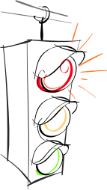
Synchronization
int MPI_Barrier(MPI_Comm comm)
  Blocks until all processes in the communicator have reached here
Barrier

Slide 77
MPI BCAST
int MPI_Bcast (void *buffer, int count,
MPI_Datatype datatype, int root, MPI_Comm comm)
rank 0
Initial Data
2
3
MPI_BCAST
2
3
2
3
2
3
2
3
rank 0
rank 1
rank 2
rank 3

Slide 78
MPI_Bcast (examples)
#include <stdio.h>
#include <mpi.h>
int main(int argc, char *argv[]){
int i, rank, nprocs;
int buf[2] = { 0, 0 };
MPI_Init(&argc, &argv);
MPI_Comm_size(MPI_COMM_WORLD, &nprocs);
MPI_Comm_rank(MPI_COMM_WORLD, &rank);
if (rank == 0) {
buf[0] = 2; buf[1] = 3;
}
printf("rank (%d) : Before : ", nrank);
for (i=0; i<2; i++) printf(" %d", buf[i]);
MPI_Bcast(buf,4, MPI_INT, 0, MPI_COMM_WORLD);
printf(“\n rank (%d) : After : ", nrank);
for (i=0; i<2; i++) printf(" %d", buf[i]);
printf("\n");
MPI_Finalize();
}

Slide 79
Reduction Operations
Combine data from several processes to produce a single result
Strike

Slide 80
Global Reduction Operations
Reduction
  Used to compute a result involving data distributed over a group of processes
  Examples:
    global sum or product
    global maximum or minimum
    global user-defined operation

Slide 81
MPI_REDUCE
Operation | Data Type (C)
MPI_SUM(sum), MPI_PROD(product) MPI_MAX(maximum), MPI_MIN(minimum) | MPI_INT, MPI_LONG, MPI_SHORT, MPI_UNSIGNED_SHORT, MPI_UNSIGNED MPI_UNSIGNED_LONG, MPI_FLOAT, MPI_DOUBLE, MPI_LONG_DOUBLE
MPI_MAXLOC(max value and location), MPI_MINLOC(min value and location) | MPI_FLOAT_INT, MPI_DOUBLE_INT, MPI_LONG_INT, MPI_2INT, MPI_SHORT_INT, MPI_LONG_DOUBLE_INT
MPI_LAND(logical AND), MPI_LOR(logical OR), MPI_LXOR(logical XOR) | MPI_INT, MPI_LONG, MPI_SHORT, MPI_UNSIGNED_SHORT, MPI_UNSIGNED MPI_UNSIGNED_LONG
MPI_BAND(bitwise AND), MPI_BOR(bitwise OR), MPI_BXOR(bitwise XOR) | MPI_INT, MPI_LONG, MPI_SHORT, MPI_UNSIGNED_SHORT, MPI_UNSIGNED MPI_UNSIGNED_LONG, MPI_BYTE

Slide 82
Reduction Operations (examples)
rank 0
rank 1
rank 2
rank 3
Initial Data
2
3
4
2
0
1
3
2
MPI_REDUCE with MPI_MIN; root=0
0
1
-
-
-
-
-
-
MPI_ALLREDUCE
With MPI_MAX
4
3
4
3
4
3
4
3
MPI_REDUCE with MPI_SUM; rank=2
-
-
-
-
9
8
-
-

Slide 83
MPI_Reduce (Example)
int main(int argc, char *argv[]){
int i, rank, start, end;
double a[9], sum=0.0, total_sum = 0.0;
MPI_Init(&argc, &argv);
MPI_Comm_rank(MPI_COMM_WORLD, &nrank);
start = rank * 3; end = start + 2;
for (i=start; i<end+1; i++) {oo
a[i] = i + 1;
if (i == start) printf("rank (%d) ", rank);
printf("a[%d] = %.2f ", i, a[i]);
}
for (i=start; i<end+1; i++) sum = sum + a[i];
MPI_Reduce(&sum, &total_sum, 1, MPI_DOUBLE, MPI_SUM, 0, MPI_COMM_WORLD);
if (nrank == 0)
printf("\nrank(%d):sum= %.2f.\n",rank, total_sum);
MPI_Finalize();
}

Slide 84
MPI_GATHER
rank 0
rank 1
rank 2
rank 3
Initial Data
2
3
0
6
MPI_GATHER
2
3
0
6
rank 0

Slide 85
MPI_GATHER (Example)
#include <stdio.h>
#include <mpi.h>
int main(int argc, char *argv[]){
int i, nprocs, rank, isend, irecv[4];
MPI_Init(&argc, &argv);
MPI_Comm_size(MPI_COMM_WORLD, &nprocs);
MPI_Comm_rank(MPI_COMM_WORLD, &rank);
isend = rank + 1;
printf("rank (%d) : isend = %d\n", rank, isend);
MPI_Gather(&isend, 1, MPI_INT, irecv, 1, MPI_INT, 0, MPI_COMM_WORLD);
if (rank == 0)
for (i=0; i<3; i++)
printf("rank (%d) : irecv[%d] = %d\n",
nrank, i, irecv[i]);
MPI_Finalize();
}

Slide 86
MPI_SCATTER
MPI_Scatter(sendbuf, sendcount, MPI_INT, recvbuf, recvcount, MPI_INT, root, MPI_COMM_WORLD)
rank 0
Initial Data
2
3
0
6
MPI_SCATTER
2
3
0
6
rank 0
rank 1
rank 2
rank 3

Slide 87
MPI_SCAN
MPI_Scan(sendbuf, recvbuf, count, MPI_INT, MPI_SUM,
MPI_COMM_WORLD)
rank 0
rank 1
rank 2
rank 3
sendbuf(before)
2
3
0
6
recvbuf(after)
2
5
5
11
rank 0
rank 1
rank 2
rank 3

Slide 88
MPI_ALLTOALL
rank 0
rank 1
rank 2
rank 3
a
b
c
d
e
f
g
h
i
j
k
l
m
n
o
p
a
b
c
d
e
f
g
h
i
j
k
l
m
n
o
p
a
e
i
m
b
f
j
n
c
g
k
o
d
h
l
p
rank 0
rank 1
rank 2
rank 3

Slide 89
Lab #5
Counting3s

Slide 90
Case study #3: counting 3’s (1/3)
2
3
6
9
8
1
0
3
3
3
4
3
9
0
0
0
1
2
3
4
5
6
7
8
9
Rank=0
Rank=1
Rank=2
Rank=3
Rank=4
int main(int argc, char **argv) {
const int length = 100000000, iters = 10;
int myid, nprocs, length_per_process, i, j, p;
int *myArray, *gArray, root, tag, myCount, gCount;
FILE *fp; double t1, t2;
myCount = 0; root=0; tag=0;
length_per_process=length/nprocs;
myArray=(int *)malloc(length_per_process*sizeof(int));

Slide 91
Count3s_serial.c
#include <stdio.h>
int main(int argc, char **argv){
int nSize = 1000*1000*10;
int i, icount, *array;
array = (int *)malloc(nSize * sizeof(int));
for (i = 0; i < nSize; i++)
array[i] = rand()%10;
icount =0;
for (i = 0; i < nSize; i++) {
if (array[i] == 3)
icount++;
}
printf("nSize=%d Count=%d\n",nSize, icount);
}
$icc count3s.c
$./a.out
nSize=10000000 Count=999471

Slide 92
Parallel MPI : Counting3s
Rank 0
4
1
5
3
6
1
0
8
3
9
3
3
Rank 0
(Scatter)
Rank 1
Rank 2
4
1
5
3
6
1
0
8
3
9
3
3
1
(For/Do loop)
0
(For/Do loop)
3
(For/Do loop)
Rank 0
(Reduce:+)
4

Slide 93
Parallel MPI : Block distribution
Rank 0
globalA[nSize]
4
1
5
3
6
1
0
8
3
9
3
3
Rank 0
localA[locN]
Rank 1
Rank 2
4
1
5
3
6
1
0
8
3
9
3
3
1
(For/Do loop)
0
(For/Do loop)
3
(For/Do loop)
Rank 0
(Reduce:+)
4

Slide 94
MPI_Scatter(globalA, locN, MPI_INT, localA, locN, MPI_INT, root,MPI_COMM_WORLD);
MPI_Reduce(&icount, &totalC, 1, MPI_INT, MPI_SUM, root, MPI_COMM_WORLD);

Slide 95
Exe1: Count3s.c
$mpicc mpic3s-p2p-nonb.c
$mpirun -np 4 ./a.out
nprocs= 4 nSize=1000000000 4.0000(GB) Err=1.330700E-05 eTime=13.98861(sec)
np=4 memA=12.6541 MPI_Send=2.28882e-05 Hopspot=0.10075 MPI_Recv=1.23375
nprocs | memAlloc | Send (Scatter) | Counting (hot-spot) | Recv (Reduction) | total
1
2
4
8

Slide 96
Exe2: Count3s.c
$mpicc mpic3s-p2p-nonb.c
$mpirun -np 4 ./a.out
nprocs= 4 nSize=1000000000 4.0000(GB) Err=1.330700E-05 eTime=13.98861(sec)
np=4 memA=12.6541 MPI_Send=2.28882e-05 Hopspot=0.10075 MPI_Recv=1.23375
Nprocs (8) | memAlloc | Send (Scatter) | Counting (hot-spot) | Recv (Reduction) | Total
nonblock | 1.59 | 1.89 | 13.1 | 1.29 | 17.9
blocking | 1.5(8) | 2.0(8) | 14.2(8) | 2.6(8) | 20.2(8)
blocking | 1.54 | 1.88 | 13.29 | 2.03 | 18.76
collective | 1.53 | 2.05 | 14.03 | 2.99

Slide 97
Exe3: Count3s.c
Nprocs (8) | memAlloc | Send (Scatter) | Counting (hot-spot) | Recv (Reduction) | total
Blocking
Nonblocking
Scatter
Reduce

Slide 98
Lab #6
1D Jacobi

Slide 99
Simple parallelization example
P0
P1
P2
P3
i-1
i
i+1
T[i]
Tnew[i]

Slide 100
Case study #4 : Jacobi solver (1/4)
Jacobi iterator is a way of solving Poisson’s equation using an iterative scheme
Vnew(i,j) = [V(i-1,j)+V(i+1,j)+ V(i,j-1)+V(i,j+1)-beta(i,j)]/4

Slide 101
P0
MPI_PROC_NULL
Case study
Parallel
P1
P2
Serial

Slide 102
Jacobi-p2p.c
int main(int argc, char *argv[]){
int i,j,k; int N,M,N_global; int rank,nprocs; int up,down;
int max_iterations;
double **beta,**V,**Vn, **temp;
double t1, t2, t3, t_comm,t_comp;
MPI_Init(&argc,&argv);
MPI_Comm_rank(MPI_COMM_WORLD,&rank);
MPI_Comm_size(MPI_COMM_WORLD,&nprocs);
max_iterations=10;
N_global=1000*16;
N=N_global/nprocs;
M=N_global;
up=rank-1;
down=rank+1;
if(up<0) up=MPI_PROC_NULL;
if(down>=nprocs) down=MPI_PROC_NULL;
printf("%d has ngbrs %d,%d\n",rank,up,down);
1 has ngbrs 0,2
4 has ngbrs 3,5
5 has ngbrs 4,6
2 has ngbrs 1,3
0 has ngbrs -2,1
7 has ngbrs 6,-2
6 has ngbrs 5,7
3 has ngbrs 2,4

Slide 103
Jacobi-p2p.c
t_comp=t_comm=0.0;
for(k=0;k<max_iterations;k++){
t1 = MPI_Wtime();
if(rank%2==0){
MPI_Send(V[1],M,MPI_DOUBLE,up,10,MPI_COMM_WORLD);
MPI_Recv(V[0],M,MPI_DOUBLE,up,11,MPI_COMM_WORLD,MPI_STATUS_IGNORE);
MPI_Send(V[N],M,MPI_DOUBLE,down,12,MPI_COMM_WORLD);
MPI_Recv(V[N+1],M,MPI_DOUBLE,down,13,MPI_COMM_WORLD,MPI_STATUS_IGNORE);
}
if(rank%2==1){
MPI_Recv(V[N+1],M,MPI_DOUBLE,down,10,MPI_COMM_WORLD,MPI_STATUS_IGNORE);
MPI_Send(V[N],M,MPI_DOUBLE,down,11,MPI_COMM_WORLD);
MPI_Recv(V[0],M,MPI_DOUBLE,up,12,MPI_COMM_WORLD,MPI_STATUS_IGNORE);
MPI_Send(V[1],M,MPI_DOUBLE,up,13,MPI_COMM_WORLD);
}
t2 = MPI_Wtime();
for(i=1; i<=N; i++)
for(j=1; j<M-1; j++)
Vn[i][j]=(V[i-1][j]+V[i+1][j]+V[i][j-1]+V[i][j+1]-beta[i][j])*0.25;
t3 = MPI_Wtime();
t_comm += t2-t1;
t_comp += t3-t2;
}

Slide 104
Jacobi.c
/mpi/step5
jacobi_p2p.c
jacobi_sendrecv.c
nprocs | T_comm | T_comp | T_total | M=16000 | M=32000
2
4
8
nprocs | T_comm | T_comp | T_total | M=16000 | M=32000
2
4
8

Slide 105
Agenda
What is MPI?
  How to write a parallel program in MPI
  Basic MPI
  Point-to-point communication
Slightly more intermediated topics:
  Non-blocking communication in MPI
  Collective communication in MPI
How to parallelize your program
Summary and final Q&A

Slide 106
Parallelizing DO/FOR Loops
The parallelizing DO / FOR loops is one of the most important challenges
  The hot spots are likely to be found in DO / FOR loops
  The basic technique is to distribute iterations among processors and to let each processor do its portion in parallel

Slide 107
Block distribution
length = np*q + r
  q = length/np (quotient)
  r = length%np (reminder)
    Length=14, np=4, q=3, r=2
length =r(q+1) + (np-r)q
Iteration
rank
1
2
3
4
5
6
7
8
9
10
11
12
13
14
0
0
0
0
1
1
1
1
2
2
2
3
3
3

Slide 108
The para range subroutine
// C
void para_range(int n1,int n2, int nprocs, int myrank, int *ista, int *iend)
{
int iwork1, iwork2;
iwork1 = (n2-n1+1)/nprocs;
iwork2 = (n2-n1+1) % nprocs;
*ista= myrank*iwork1 + n1 + min(myrank, iwork2);
*iend = *ista + iwork1 - 1;
if(iwork2 > myrank) *iend = *iend + 1;
}
//Fortran
SUBROUTINE para_range(n1, n2, nprocs, irank, ista, iend)
iwork1 = (n2 - n1 + 1) / nprocs
iwork2 = MOD(n2 - n1 + 1, nprocs)
ista = irank * iwork1 + n1 + MIN(irank, iwork2)
iend = ista + iwork1 – 1
IF (iwork2 > irank) iend = iend + 1
END

Slide 109
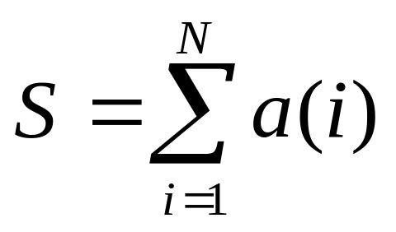
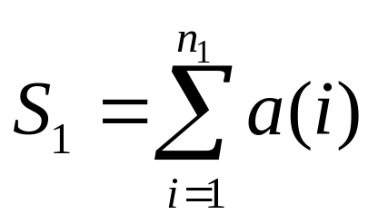
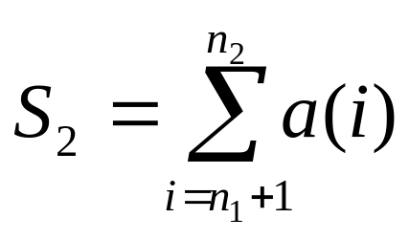
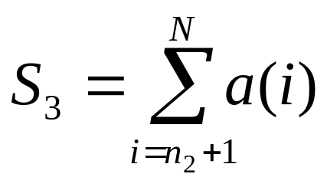
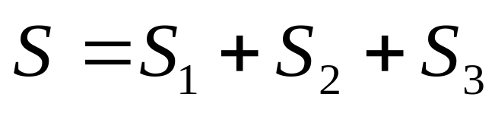
Block distribution example

Slide 110
PROGRAM parasum
INCLUDE 'mpif.h'
PARAMETER (n = 100000)
DIMENSION a(n)
CALL MPI_INIT(ierr)
CALL MPI_COMM_SIZE(MPI_COMM_WORLD, nprocs, ierr)
CALL MPI_COMM_RANK(MPI_COMM_WORLD, myrank, ierr)
CALL para_range(1, n, nprocs, myrank, ista, iend)
DO i = ista, iend
a(i) = i
ENDDO
sum = 0.0
DO i = ista, iend
sum = sum + a(i)
ENDDO
CALL MPI_REDUCE(sum,ssum,1,MPI_REAL,MPI_SUM,0,MPI_COMM_WORLD,ierr)
sum = ssum
IF (myrank == 0) PRINT *, 'sum =',sum
CALL MPI_FINALIZE(ierr)
END
subroutine para_range(n1, n2, nprocs, irank, ista, iend)
iwork1 = (n2-n1+1)/nprocs
iwork2 = MOD(n2-n1+1, nprocs)
ista = irank*iwork1 + n1 + MIN(irank, iwork2)
iend = ista + iwork1 - 1
if (iwork2>irank) iend = iend + 1
end subroutine para_range
mpif90 blockd.f90
mpirun -np 4 ./a.out
sum = 5.00000051E+09

Slide 111
// parallel sum using para_range
#include <mpi.h>
#include <stdio.h>
#define n 100000
void para_range(int, int, int, int, int*, int*);
int min(int, int);
int main (int argc, char *argv[]){
int i, nprocs, myrank ;
int ista, iend;
double a[n], sum, tmp;
MPI_Init(&argc, &argv);
MPI_Comm_size(MPI_COMM_WORLD, &nprocs);
MPI_Comm_rank(MPI_COMM_WORLD, &myrank);
para_range(1, n, nprocs, myrank, &ista, &iend);
for(i = ista-1; i<iend; i++) a[i] = i+1;
sum = 0.0;
for(i = ista-1; i<iend; i++) sum = sum + a[i];
MPI_Reduce(&sum, &tmp, 1, MPI_DOUBLE, MPI_SUM, 0, MPI_COMM_WORLD);
sum = tmp;
if(myrank == 0) printf("sum = %f \n",sum);
MPI_Finalize();
}
void para_range(int n1,int n2, int nprocs,
int myrank, int *ista, int *iend)
{
int iwork1, iwork2;
iwork1 = (n2-n1+1)/nprocs;
iwork2 = (n2-n1+1) % nprocs;
*ista= myrank*iwork1 + n1
+ min(myrank, iwork2);
*iend = *ista + iwork1 - 1;
if(iwork2 > myrank) *iend = *iend + 1;
}
int min(int x, int y){
int v;
if (x>=y) v = y;
else v = x;
return v;
}

Slide 112
Loop distribution
Block Distribution
Cyclic Distribution
Block-Cyclic Distribution
iteration | 1 | 2 | 3 | 4 | 5 | 6 | 7 | 8 | 9 | 10 | 11 | 12
rank | 0 | 0 | 0 | 1 | 1 | 1 | 2 | 2 | 2 | 3 | 3 | 3
iteration | 1 | 2 | 3 | 4 | 5 | 6 | 7 | 8 | 9 | 10 | 11 | …
rank | 0 | 1 | 2 | 3 | 0 | 1 | 2 | 3 | 0 | 1 | 2 | …
iteration | 1 | 2 | 3 | 4 | 5 | 6 | 7 | 8 | 9 | 10 | 11 | …
rank | 0 | 0 | 1 | 1 | 2 | 2 | 3 | 3 | 0 | 0 | 1 | …

Slide 113
Cyclic distribution
In cyclic distribution, the iterations are assigned to processes in a round-robin fashion.
DO i = n1, n2 computation ENDDO | DO i = n1+rank, n2, nprocs computation ENDDO
iteration
1
2
3
4
5
6
7
8
9
10
11
12
13
14
rank
0
1
2
3
0
1
2
3
0
1
2
3
0
1

Slide 114
Block-cycle distribution
DO ii = n1+rank*iblock, n2, nprocs*iblock DO i = ii, MIN(ii+iblock-1, n2) computation ENDDO ENDDO
Iteration
Rank
1
2
3
4
5
6
7
8
9
10
11
12
13
14
0
0
1
1
2
2
3
3
0
0
1
1
2
2
iblock

Slide 115
Shrinking Arrays
Extremely important for efficient memory management!!!
Block distribution of 14 iterations over 4 cores.
Each MPI process needs only part of the array a()
A()
1
2
3
4
5
6
7
8
9
10
11
12
13
14
Rank 0
1
2
3
4
Rank 1
5
6
7
8
Rank 2
9
10
11
Rank 3
12
13
14

Slide 116
Nested loop parallelization
Minimize cache misses
Minimize communication
a(i,j)
a[i][j]
j
j
1
2
3
4
5
ㆍ
ㆍ
ㆍ
N
0
1
2
3
4
ㆍ
ㆍ
ㆍ
N-1
1
0
i
i
2
1
3
2
4
3
5
4
ㆍ
ㆍ
ㆍ
ㆍ
ㆍ
ㆍ
N
N-1
Column-major order for Fortran
Row-major order in C

Slide 117
Minimize cache misses
The larger number of cache misses due to a large stride makes Loop B much slower than loop A
Loop A (column-major) | Loop B (row-major )
DO j = 1, n DO i = 1, n a(i,j) = b(i,j) + c(i,j) ENDDO ENDDO | DO i = 1, n DO j = 1, n a(i,j) = b(i,j) + c(i,j) ENDDO ENDDO
➔ Parallelize Loop A

Slide 118
Memory access pattern
a(i,j)
j
a(i,j)
j
Process 0
Process 1
Process 2
i
i
P 0
P1
P 2
(1) Loop A1
(2) Loop A2
➔ To parallelize the outer loop as in Loop A1 due to fewer cache misses.

Slide 119
Minimize communication
Choose a distribution as close as square as possible
  Three ways of distribution a 24x24 matrix to 12 cores
  The maximum # to be transmitted per core is 48, 26, 24

Slide 120
Lab #7
Parallel Pi

Slide 121
Agenda
What is MPI?
  How to write a parallel program in MPI
  Basic MPI
  Point-to-point communication
Slightly more intermediated topics:
  Non-blocking communication in MPI
  Collective communication in MPI
How to parallelize your program
Summary and final Q&A

Slide 122
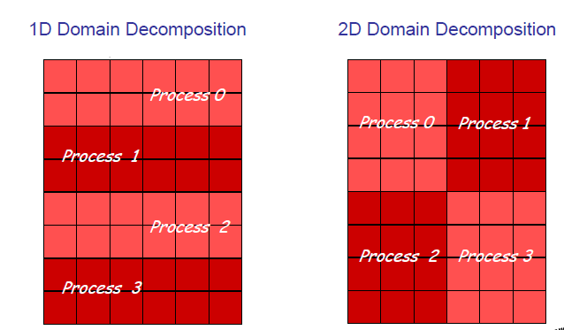
Domain Decompositions
Ref: Dr. David Ennis (http://scv.bu.edu/~kadin/intermediate-mpi/)

Slide 123
1D Finite Difference Method
1D FDM
Fortran | C
PROGRAM 1D_fdm_serial IMPLICIT REAL*8 (a-h, o-z) PARAMETER (n=11) DIMENSION a(n), b(n) DO i = 1, n b(i) = i ENDDO DO i = 2, n-1 a(i) = b(i-1) + b(i+1) ENDDO END | /*1D_fdm_serial*/ #define n 11 main(){ double a[n], b[n]; int i; for(i=0; i<n; i++) b[i] = i+1; for(i=1; i<n-1; i++) a[i] = b[i-1] + b[i+1]; }

Slide 124
Data dependence in 1D FDM
b(1)
b(2)
b(3)
b(4)
b(5)
b(6)
b(7)
b(8)
b(9)
b(10)
b(11)
1
2
3
4
5
6
7
8
9
10
11
a(2)
a(3)
a(4)
a(5)
a(6)
a(7)
a(8)
a(9)
a(10)
4
6
8
10
12
14
16
18
20

Slide 125
Data dependence and movements
Process 0
Process 1
Process 2
ista
iend
ista
iend
ista
iend
b
1
2
3
4
b
5
6
7
8
b
9
10
11
send
send
send
send
receive
receive
receive
receive
ista
iend
ista
iend
ista
iend
b
1
2
3
4
5
b
4
5
6
7
8
9
b
8
9
10
11
a
4
6
8
a
10
12
14
16
a
18
20
ista2
iend1
ista2
iend1
ista2
iend1

Slide 126
1D FDM : Fortran (1/2)
PROGRAM parallel_1D_fdm
INCLUDE ‘mpif.h’
PARAMETER (n=11)
DIMENSION a(n), b(n)
INTEGER istatus(MPI_STATUS_SIZE)
CALL MPI_INIT(ierr)
CALL MPI_COMM_SIZE(MPI_COMM_WORLD, nprocs, ierr)
CALL MPI_COMM_RANK(MPI_COMM_WORLD, myrank, ierr)
CALL para_range(1, n, nprocs, myrank, ista, iend)
ista2 = ista; iend1 = iend
IF (myrank == 0) ista2 = 2
IF (myrank == nprocs-1) iend1 = n-1
inext = myrank + 1; iprev = myrank – 1
IF (myrank == nprocs-1) inext = MPI_PROC_NULL
IF (myrank == 0) iprev = MPI_PROC_NULL
DO i = ista, iend
b(i) = i
ENDDO

Slide 127
1D FDM : Fortran (2/2)
CALL MPI_ISEND(b(iend), 1, MPI_REAL, inext, 1, &
MPI_COMM_WORLD, isend1, ierr)
CALL MPI_ISEND(b(ista), 1, MPI_REAL, iprev, 1, &
MPI_COMM_WORLD, isend2, ierr)
CALL MPI_IRECV(b(ista-1), 1, MPI_REAL, iprev, 1, &
MPI_COMM_WORLD, irecv1, ierr)
CALL MPI_IRECV(b(iend+1), 1, MPI_REAL, inext, 1, &
MPI_COMM_WORLD, irecv2, ierr)
CALL MPI_WAIT(isend1, istatus, ierr)
CALL MPI_WAIT(isend2, istatus, ierr)
CALL MPI_WAIT(irecv1, istatus, ierr)
CALL MPI_WAIT(irecv2, istatus, ierr)
DO i = ista2, iend1
a(i) = b(i-1) + b(i+1)
ENDDO
CALL MPI_FINALIZE(ierr)
END

Slide 128
1D FDM : C (1/2)
/*parallel_1D_fdm*/
#include <mpi.h>
#define n 11
void para_range(int, int, int, int, int*, int*);
int min(int, int);
main(int argc, char *argv[]){
int i, nprocs, myrank ;
double a[n], b[n];
int ista, iend, ista2, iend1, inext, iprev;
MPI_Request isend1, isend2, irecv1, irecv2;
MPI_Status istatus;
MPI_Init(&argc, &argv);
MPI_Comm_size(MPI_COMM_WORLD, &nprocs);
MPI_Comm_rank(MPI_COMM_WORLD, &myrank);
para_range(0, n-1, nprocs, myrank, &ista, &iend);
ista2 = ista; iend1 = iend;
if(myrank==0) ista2=1;
if(myrank==nprocs-1)iend1=n-2;

Slide 129
1D FDM : C (2/2)
inext=myrank+1; iprev=myrank-1;
if(myrank==nprocs-1) inext=MPI_PROC_NULL;
if(myrank==0) iprev=MPI_PROC_NULL;
MPI_Isend(&b[iend], 1, MPI_DOUBLE, inext ,1, MPI_COMM_WORLD, &isend1);
MPI_Isend(&b[ista], 1, MPI_DOUBLE, iprev, 1, MPI_COMM_WORLD, &isend2);
MPI_Irecv(&b[ista-1], 1, MPI_DOUBLE, iprev, 1, MPI_COMM_WORLD, &irecv1);
MPI_Irecv(&b[iend+1], 1, MPI_DOUBLE, inext, 1, MPI_COMM_WORLD, &irecv2);
MPI_Wait(&isend1, &istatus);
MPI_Wait(&isend2, &istatus);
MPI_Wait(&irecv1, &istatus);
MPI_Wait(&irecv2, &istatus);
for(i=ista2; i<=iend1; i++) a[i] = b[i-1] + b[i+1];
MPI_Finalize();
}

Slide 130
Contiguous data; non-overlapping
  Use MPI_GATHERV
Process 0
Process 1
Process 2
j
A(i,j)
1
N
A
1
N
A
1
N
i
1
0
2
4
6
1
8
10
12
1
14
16
18
M
1
3
5
7
M
9
11
13
M
15
17
19
jsta
jend
jsta
jend
jsta
jend
idisp(0)
idisp(1)
idisp(2)
B
1
N
1
0
2
4
6
8
10
12
14
16
18
M
1
3
5
7
9
11
13
15
17
19
jjlen(0)=2×4
jjlen(1)=2×3
jjlen(2)=2×3

Slide 131
Contiguous data; non-overlapping
REAL a(m,n), b(m,n) INTEGER, ALLOCATABLE :: idisp(:), jjlen(:) ... ALLOCATE (idisp(0:nprocs-1), jjlen(0:nprocs-1)) DO irank = 0, nprocs - 1 CALL para_range(1, n, nprocs, irank, jsta, jend) jjlen(irank) = m * (jend - jsta + 1) idisp(irank) = m * (jsta - 1) ENDDO CALL para_range(1, n, nprocs, myrank, jsta, jend) ... CALL MPI_GATHERV(a(1,jsta), jjlen(myrank), MPI_REAL, & b, jjlen, idisp, MPI_REAL, 0, MPI_COMM_WORLD, ierr) DEALLOCATE (idisp, jjlen) …

Slide 132
Contiguous data; non-overlapping
double a[m][n], b[m][n]; int *idisp, *iilen; … idisp = (int *)malloc(nprocs*sizeof(int)); iilen = (int *)malloc(nprocs*sizeof(int)); for(irank = 0; irank<nprocs; irank++){ para_range(0, m-1, nprocs, irank, &ista, &iend); iilen[irank] = n*(iend-ista+1); idisp[irank] = n*ista; } para_range(0, m-1, nprocs, myrank, &ista, &iend); … MPI_Gatherv(&a[ista][0], iilen[myrank], MPI_DOUBLE, b, iilen, idisp, MPI_DOUBLE, 0, MPI_COMM_WORLD); free(idisp); free(iilen); …

Slide 133
Contiguous; Overlapping Buffers
  Use Point-to-Point Communication
Process 0
Process 1
Process 2
j
jjlen(0)=2×4
jjlen(1)=2×3
jjlen(2)=2×3
A(i,j)
1
N
A
1
N
A
1
N
i
1
0
2
4
6
8
10
12
14
16
18
1
8
10
12
1
14
16
18
M
1
3
5
7
9
11
13
15
17
19
M
9
11
13
M
15
17
19
jsta(0)
jsta(1)
jsta(2)
jsta
jend
jsta
jend

Slide 134
Contiguous; Overlapping Buffers
IF (myrank == 0) THEN DO irank = 1, nprocs - 1 CALL MPI_IRECV(a(1,jjsta(irank)),jjlen(irank),MPI_REAL,& irank, 1, MPI_COMM_WORLD, iireq(irank),ierr) ENDDO DO irank = 1, nprocs - 1 CALL MPI_WAIT(iireq(irank), istatus, ierr) ENDDO ELSE CALL MPI_ISEND(a(1,jsta), jjlen(myrank), MPI_REAL, & 0, 1, MPI_COMM_WORLD, ireq, ierr) CALL MPI_WAIT(ireq, istatus, ierr) ENDIF DEALLOCATE (jjsta, jjlen, iireq) …

Slide 135
Contiguous; Overlapping Buffers
double a[m][n]; int *iista, *iilen; MPI_Request *iireq; MPI_Status istatus; … iista = (int *)malloc(nprocs*sizeof(int)); iilen = (int *)malloc(nprocs*sizeof(int)); iireq = (int *)malloc(nprocs*sizeof(int)); for(irank = 0; irank<nprocs; irank++){ para_range(0, m-1, nprocs, irank, &ista, &iend); iista[irank] = ista; iilen[irank] = n*(iend-ista+1); } para_range(0, m-1, nprocs, myrank, &ista, &iend);

Slide 136
Contiguous; Overlapping Buffers
… if (myrank == 0) { for(irank = 1; irank<nprocs; irank++) MPI_Irecv(&a[0][iista[irank]], iilen[irank], MPI_DOUBLE, irank, 1, MPI_COMM_WORLD, &iireq[irank]); for(irank = 1; irank<nprocs; irank++) MPI_Wait(&iireq[irank], &istatus); } else { MPI_Isend(&a[0][ista], iilen[myrank], MPI_DOUBLE, 0, 1, MPI_COMM_WORLD, &iireq); MPI_Wait(&ireq, &istatus); } free(iista); free(iilen); free(iireq); …

Slide 137
Synchronizing data; non-overlapping
  Only call MPI_ALLGAHERV
Process 0
Process 1
Process 2
A
1
N
A
1
N
A
1
N
1
0
2
4
6
1
8
10
12
1
14
16
18
M
1
3
5
7
M
9
11
13
M
15
17
19
jsta
jend
jsta
jend
jsta
jend
idisp(0)
idisp(1)
idisp(2)
B
1
N
B
1
N
B
1
N
1
0
2
4
6
8
10
12
14
16
18
1
0
2
4
6
8
10
12
14
16
18
1
0
2
4
6
8
10
12
14
16
18
M
1
3
5
7
9
11
13
15
17
19
M
1
3
5
7
9
11
13
15
17
19
M
1
3
5
7
9
11
13
15
17
19
jjlen(0)=2×4
jjlen(1)=2×3
jjlen(2)=2×3

Slide 138
Synchronizing data; non-overlapping
REAL a(m,n), b(m,n) INTEGER, ALLOCATABLE :: idisp(:), jjlen(:) ... ALLOCATE (idisp(0:nprocs-1), jjlen(0:nprocs-1)) DO irank = 0, nprocs - 1 CALL para_range(1, n, nprocs, irank, jsta, jend) jjlen(irank) = m * (jend - jsta + 1) idisp(irank) = m * (jsta - 1) ENDDO CALL para_range(1, n, nprocs, myrank, jsta, jend) ... CALL MPI_ALLGATHERV(a(1,jsta), jjlen(myrank), MPI_REAL, & b, jjlen, idisp, MPI_REAL, MPI_COMM_WORLD, ierr) DEALLOCATE (idisp, jjlen) …

Slide 139
Synchronizing data; non-overlapping
double a[m][n], b[m][n]; int *idisp, *iilen; … idisp = (int *)malloc(nprocs*sizeof(int)); iilen = (int *)malloc(nprocs*sizeof(int)); for(irank = 0; irank<nprocs; irank++){ para_range(0, m-1, nprocs, irank, &ista, &iend); iilen[irank] = n*(iend-ista+1); idisp[irank] = n*ista; } para_range(0, m-1, nprocs, myrank, &ista, &iend); … MPI_Allgathrev(&a[ista][0], iilen[myrank], MPI_DOUBLE, b, iilen, idisp, MPI_DOUBLE, 0, MPI_COMM_WORLD); free(idisp); free(iilen); …

Slide 140
Thinking Parallel
And Applications
PART IV

Slide 141
2D Message Passing
Five-point stencil
Processor 7
Processor 8
Processor 6
Processor 3
Processor 4
Processor 5
Processor 0
Processor 1
Processor 2

Slide 142
CASE II: Hybrid MPI+OpenMP
Multi-Zone (MZ) NAS Parallel Benchmarks
  Multilevel applications using MPI and OpenMP
  BT-MZ is a block tri-diagonal code
  The size of zones varies widely 20

Slide 143
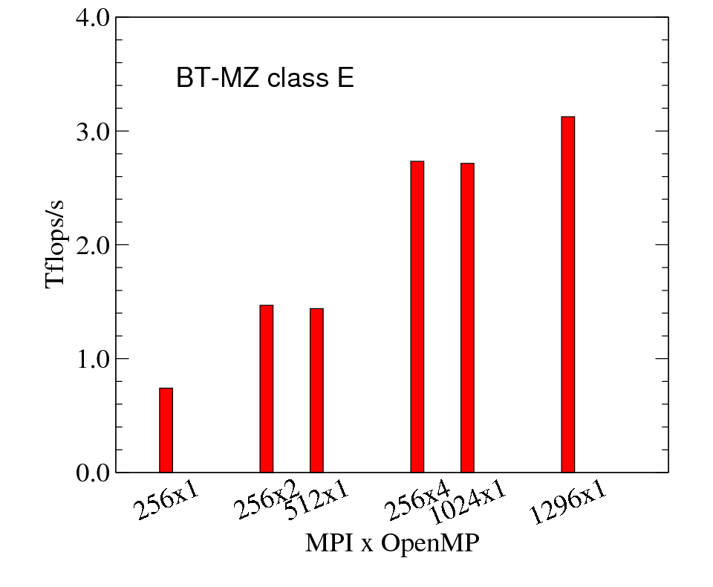
Bin-packing Algorithm for BT-MZ
  Load balancing using thread reassignment (bin-packing)
Class F achieved
the best percentage
of peak performance
(13%~15%)

Slide 144
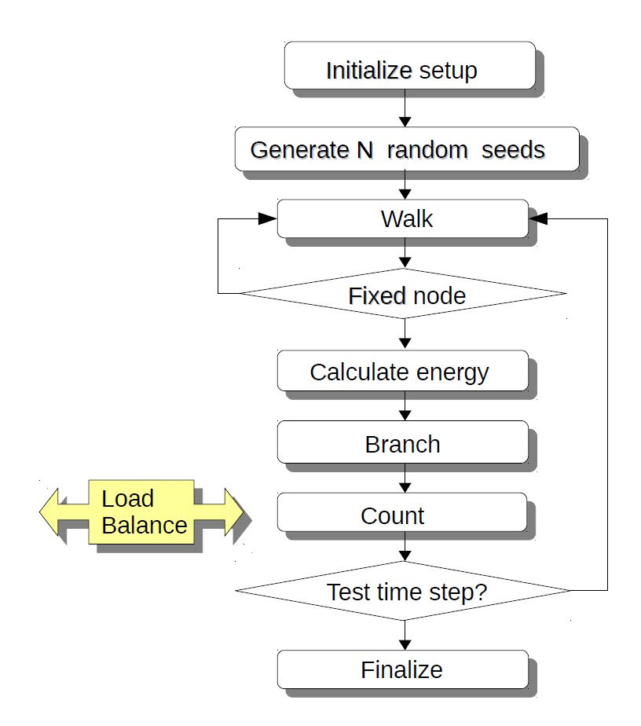
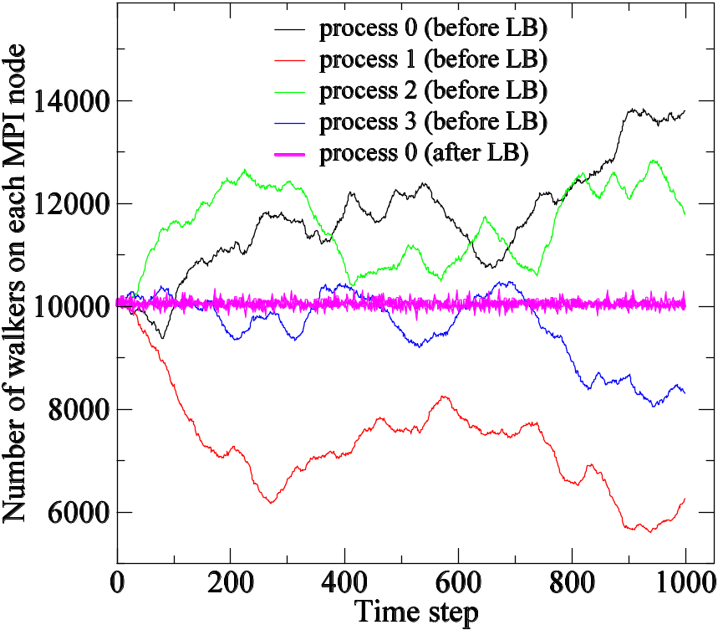
CASE III : Embarrassingly Parallel
Embarrassingly parallel application
  Quantum Monte Carlo simulations are typically EP.

Slide 145
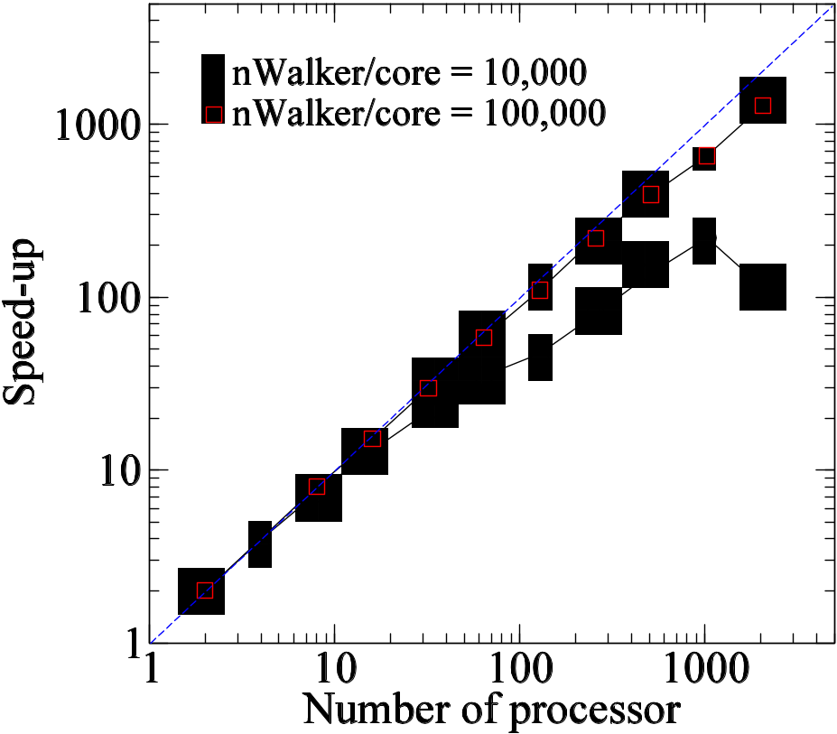
Load balancing and Performance
nwalkers
p1
p2
p3
p4
times
p1
p2
p3
p4
MPI_Send(), MPI_Recv()
p1
p2
p3
p4
MPI_Send(), MPI_Recv()
Load balancing algorithm using MPI_REDUCE with MAXLOC

Slide 146
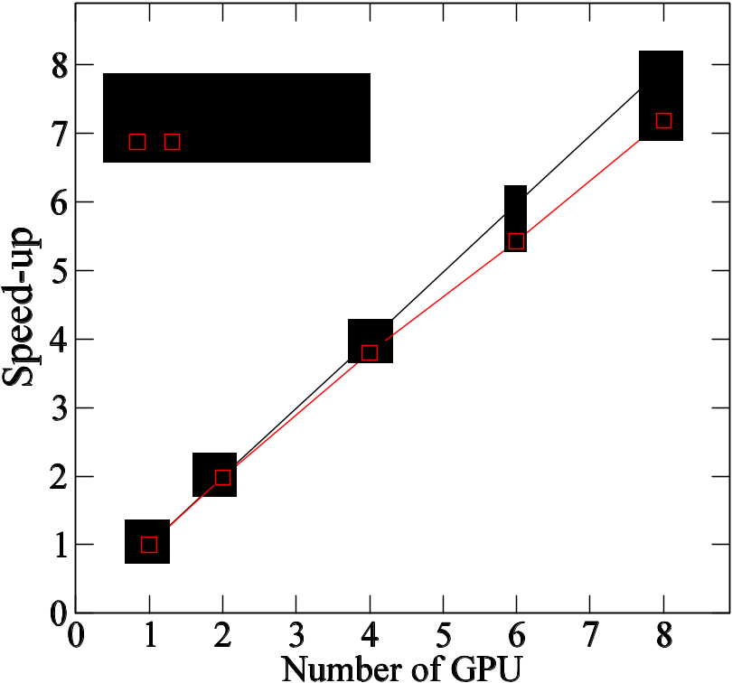
CASE IV: Multi-GPU Parallelism
Host 4
Host 2
GPU 3
GPU 2
MPI_SENDRECV
Host 3
Host 1
Offloading (in/out)
GPU 4
GPU 1
Neighbor border
An MPI Cartesian Topology with a 2D virtual MPI processes with PBC

Slide 147
Agenda
What is MPI?
  How to write a parallel program in MPI
  Point-to-point communication
Slightly more intermediated topics:
  Non-blocking communication in MPI
  Collective communication in MPI
  Derived Datatype
  Virtual Topology
How to parallelize your program
Summary

Slide 148
Handling Non-Contiguous Data
How to send only the red elements of V?
It requires inefficient copy of non-contiguous data
V(0)
V(1)
V(2)
V(3)
V(4)
V(5)
V(6)
V(7)
V(8)
V(2)
V(4)
V(6)
MPI_Send

Slide 149
Derived Data types
Define a new data type,
  A vector with stride of two from original
V(0)
V(1)
V(2)
V(3)
V(4)
V(5)
V(6)
V(7)
V(8)
blocklength = 1
Stride=2
Count=3
vType
int MPI_Type_vector (int count, int blocklength, int stride,
MPI_Datatype oldtype, MPI_Datatype *newtype)
MPI_Type_vector (3, 1, 2, MPI_DOUBLE, &vType);
MPI_Send (V[2], 1, vType, dest, tag, MPI_COMM_WORLD);

Slide 150
Equivalent Vector Datatypes
count = 3
blocklength = 2
stride = 4
count = 2
blocklength = 3
stride = 5

Slide 151
Virtual Topology
MPI provides functions to map application topology to processor topology
0 (0,0)
1 (0,1)
2 (0,2)
3 (0,3)
4 (1,0)
5 (1,1)
6 (1,2)
7 (1,3)
8 (2,0)
9 (2,1)
10 (2,2)
11 (2,3)

Slide 152
MPI_Sendrecv
Concept
in practice
Actual
Implementation
westward_send_buffer
westward_recv_buffer

Slide 153
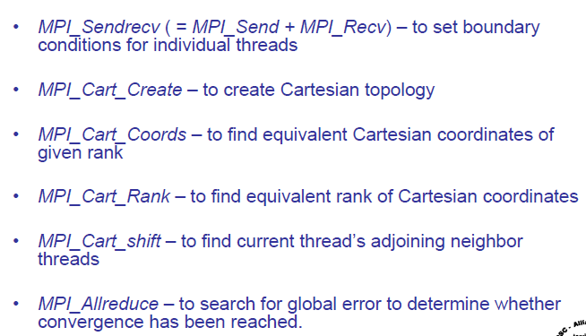
Virtual Topology (MPI) Functions
Ref: Dr. David Ennis (http://scv.bu.edu/~kadin/intermediate-mpi/)

Slide 154
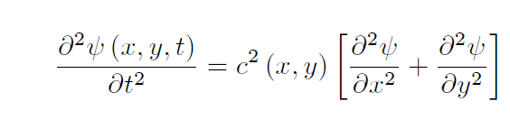
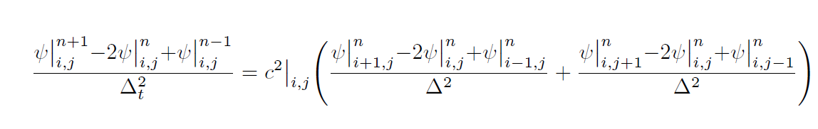
2D wave equation
Central Finite Difference Method

Slide 155

ny
nx/nprocs

Slide 156
P0
MPI_PROC_NULL
Case study
Parallel
P1
P2
Serial

Slide 157
Summary
Parallelism is critical today
MPI is an industry standard model for parallel programming
  A large number of implementations of MPI exist
  Gives user explicit control on data management
  Widely used by many scientific applications with great success
Your application can be next!

